Slide 2
June 16th and 17th, 2015 www.kvecsstln.weebly.com
Today’s Facilitators
Carole Mullins
Jamee Barton
Jennifer Fraker
Kim Sergent
Ryan New

Slide 3
What is Quality?
Practice Checking
For Quality
Create Quality

Slide 4
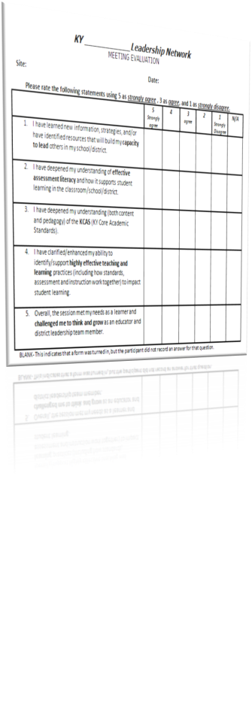
Tracking Your Day

Slide 5
Grade Level
Or
Course

Slide 6
Timeline Updates
Exploration
Notes:
10 min

Slide 7
Question Focus
RULES FOR PRODUCING QUESTIONS:
Ask as many questions as you can.
Do not stop to answer, judge or discuss.
Write down every question exactly as it was stated.
Change any statements into questions.
Notes:
Time to read articles – 5 min
5 minutes for questions
2-3 minutes for sharing

Slide 8
Question Focus
RULES FOR PRODUCING QUESTIONS:
Ask as many questions as you can.
Do not stop to answer, judge or discuss.
Write down every question exactly as it was stated.
Change any statements into questions.
Notes:
5 minutes for questions
2-3 sharing top

Slide 9
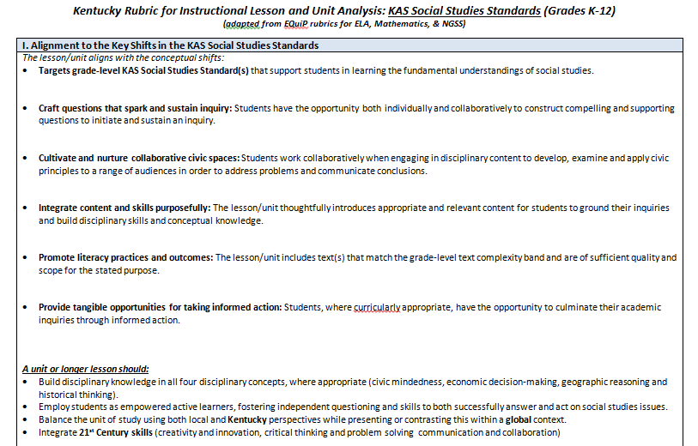
What is Quality?

Slide 10
Dimension I: Alignment to the Key Shifts

Slide 11
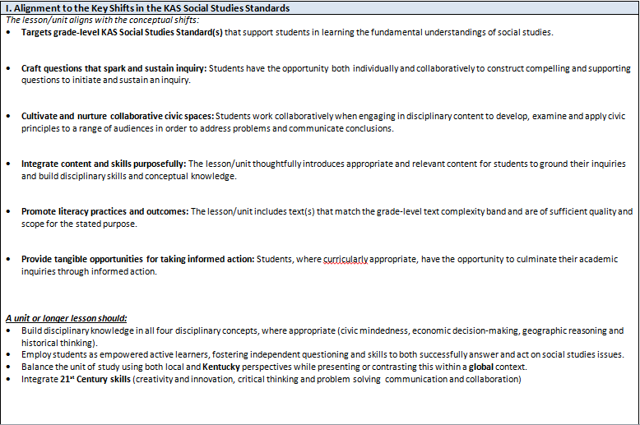
Alignment to the Key Shifts in the KAS Social Studies Standards

Slide 12
Review rubric
Underline unfamiliar terms
Share around
table to define
Populate a sticky note
per table with 3 terms
You would like to discuss
further

Slide 13
Dimension II: Instructional Supports
Dimension III: Monitoring Student
Progress of Fundamental Understandings

Slide 14
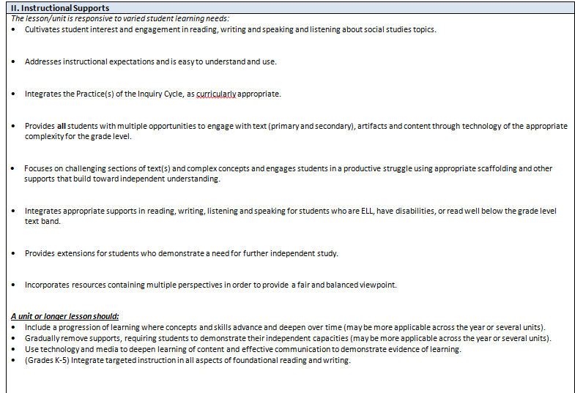
II. Instructional Supports

Slide 15
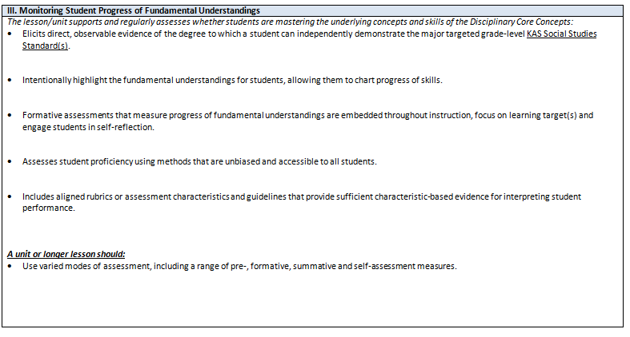
III. Monitoring Student Progress of Fundamental Understandings

Slide 16
Time | Activity
25 min | Analyze the unit to find evidence for each EQuiP indicator of lesson quality.
5 min | Share EVIDENCE for each indicator.

Slide 17
Standing Meeting
1
Move to the chart denoted with the same number written at the top of the lesson you analyzed.
Which indicators would require additional time and support to understand and apply the indicator?
What content and skills were purposefully addressed in the unit?
Discuss the role text played in delivering content/information to students compared to traditional methods?

Slide 18
Possible Shifts
Create compelling/supporting questions
Incorporate new standards in more lessons
Teach use of evidence to support claims
Incorporate disciplinary processes in more lessons
Build assessments around the Inquiry Cycle
Create more opportunities to take informed action
Teach students to evaluate the types of sources to help answer the compelling/supporting question

Slide 19
To a Shift
Instead of __________,
I’m going to __________.
(a practice to be adjusted)
(a shift)

Slide 20
Add your shift to
your nametag
Shift

Slide 21
Process
Shifts in Practice
What aspects of quality from the rubric do we most need to focus?
How can we use the
EQuiP rubric in our
school/district?
What do we want our students’ experience in SS to look like?
What instructional shifts would our district/ school like to make?

Slide 22
Lunch
https://www.youtube.com/watch?v=RPPLHq_gsP8
Notes:
https://www.youtube.com/watch?v=RPPLHq_gsP8

Slide 23
Standards
Assessment
Targets
Activities
Backwards
Mapping

Slide 24
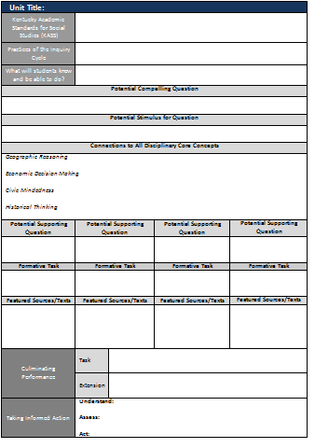
Unit Plan
Summary

Slide 25
KASSS– document NEW and old standards intended to be taught and assessed.
Which practices and how much of those will be addressed and assessed?
When students master this unit, they will be able to…. Mastery looks like….

Slide 26
What is the question (whether student or teacher generated) that students will work/research to answer?
What hook, experience, or Q-focus will students use to generate the above compelling question?
What other lenses will students consider to answer the question? Not by standard, but what other disciplinary concepts will be introduced, reinforced, revisited, or practiced during this unit?

Slide 27
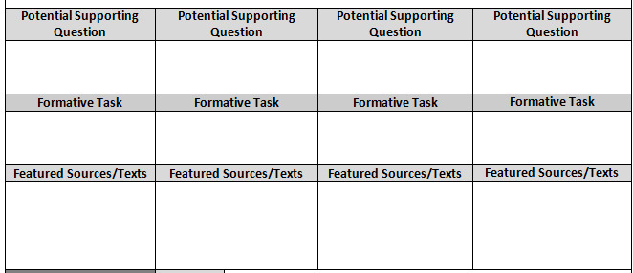
On this form, document the smaller questions (supporting questions if answered lead students to answer the bigger (compelling) question.
Formative Assessment box does not imply the ONLY assessment checkpoints on the way, rather intentional stop and check points where skills/competencies are assessed. Best practice assessment practices stipulate teachers evaluate student learning throughout their learning in an on-going process.

Slide 28
What task or experience will students demonstrate the skills/competencies developed throughout the unit? How will students demonstrate they can and know how to answer the original unit question?

Slide 29
Large Grade Level Team
Groups of 5
What new learning expectations will be in this unit as a result of adding new standards to the old standards?

Slide 30
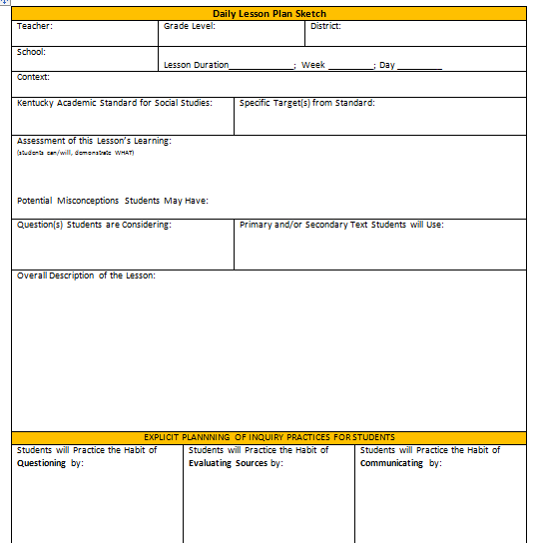
Daily Lesson Plan Sketch

Slide 31
I want to shift from
___________________________________
to
__________________________________
(Something from a previous approach to this content/context)
(Something that requires use of the “shift”)

Slide 32
Shift Group Debrief
Who | Time | Prompt
 |  | I’m thinking about shifting from ___________ to ______________.
Listeners |  | I heard you say you wanted to _____________, could you also_________?

Slide 34
Now What?
Plan unit to be taught by September 15th
Plan 1 lesson within the unit
Teach unit
Bring plan/student work back to September meeting
Be ready to share and reflect

Slide 35
Social Studies and Science Teacher Institute
July 10, 2015 (9:00-4:00 EST)
KVEC Training Center 412 Roy Campbell Drive, Hazard, KY
Register at:
https://docs.google.com/forms/d/19Ff8XnuwzcbCa0weVXjnsf-HVltM1TpTU9ysPEiOP-k/viewform?c=0&w=1
Participants should bring:
content/texts for a unit of study to use with an LDC Module
grade level content standards
a fully charged tablet/laptop

Slide 36
As You Leave
Name
District
Context
KY Academic Draft Standards
Brief Description of the Lesson

