Slide 1
Social Studies Teacher Leadership Network
April 23, 2015
www.kvecsstln.weebly.com
Notes:
WELCOME
Sit in District Teams

Slide 2
Facilitators
GUEST PRESENTERS: Latishia Sparks, KDE/KEDC
Jennifer Fraker, KDE
Jamee Barton, KDE
Carole Mullins, Literacy Instructional Specialist, KVEC
Mary McCloud, Literacy Consultant, Elem SS Facilitator, KVEC
Dionne Bates, Achievement Gap Consultant, Elem SS Facilitator, KVEC
Jennifer Carroll, Teacher and Principal Leadership, KVEC

Slide 3
Four Pillars of ISLN and TLN Meetings
Kentucky’s Core Academic Standards
Characteristics of Highly Effective Teaching and Learning/KY Framework for Teaching
Assessment Literacy
Leadership
Where is your district in the process of building capacity around these 4 pillars?
Notes:
Jennifer Carroll
9:00-9:05
Emphasize the pillars/focus areas of ISLN and TLN- ask participants to think about their role in building capacity. Who, from your district, is here today? Where do you feel you are in the process of building capacity? These are questions for you to personally think about. Think about evidence you have to support the questions. If you are building capacity for all stakeholders, what evidence do you have? Just jot your thoughts down on a sheet of paper. This is only for you to think about. How is your school/district improving as a result of your work? What reform has taken place? Who has grown as a result of your attendance at ISLN? Who has grown as a reault of district leaders attending ISLN?

Slide 4
Targets
Identify habits of mind that support rigorous, relevant and personalized learning.
Self assess Teacher Leadership Skills and identify “challenge” areas.
Reach consensus with colleagues on meaning of Next Generation Social Studies Standards.
Plan for continued work in district on understanding standards.
Identify possible evidence for Domains 1 and 4 of KYFfT that reflect accomplished/effective professional practice.
Notes:
Jennifer Carroll

Slide 5
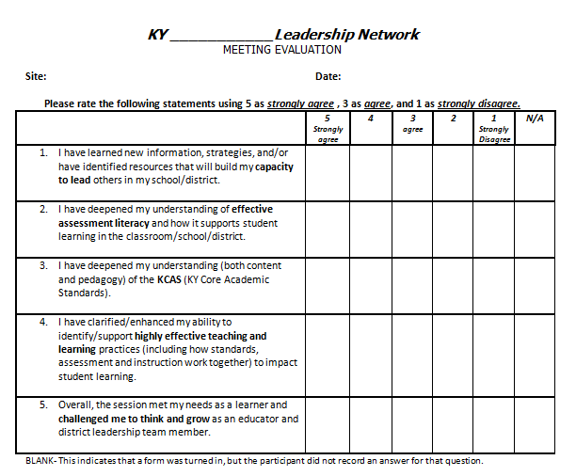
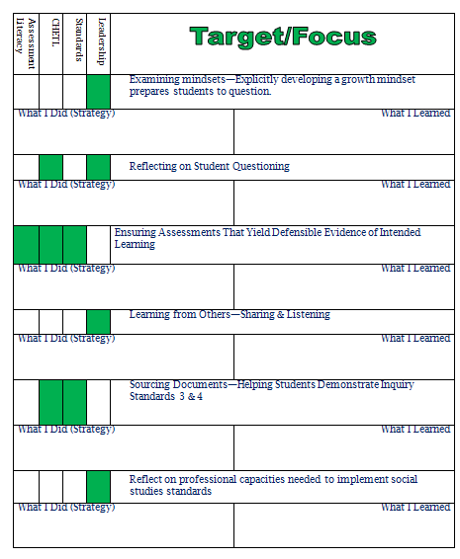
Tracking Your Day
Notes:
Jennifer
Give participants time to do the first two boxes on the evaluation

Slide 6
Kentucky Rising
Kentucky Rising establishes criteria for a high school diploma, certificate, or endorsement that certifies a graduate meets the employment requirements of foreign industries that are directly investing in the state and industries that are creating trade with other countries.
By ensuring Kentucky’s workforce is an asset to global development, Kentucky can continue to create jobs for residents that grow the state’s economy. “Global ready diploma”
Kentucky Rising both supports and intersects with ALL content areas, especially social studies. An emphasis on Kentucky Rising as an intentional focus aligns the rigor of KCAS, PGES, 21st Century Skills and Program Reviews while developing a skilled and highly adaptable workforce
Notes:
Jennifer C
9:05-9:10
Allow participants time to read over one pager on KY Rising and discuss key learning, what their district is doing around KY Rising

Slide 7
Future Ready
Maximize digital learning opportunities and help school districts move quickly toward preparing students for success in college, a career, and citizenship.
Begins with pledge and plan
Highly trained teachers
Personalized learning experiences for all students
Notes:
9:10-9:20
Video
Share some info about Future Ready-
KVEC districts are in process of signing future ready pledge and taking Future Ready assessment to determine areas of strengths and areas of work.
Allow participants time to look over this document and discuss key learning, what they know about future ready, what their district is doing in relation to future ready

Slide 8
Habits of Mind are dispositions that are skillfully and mindfully employed by characteristically successful people when they are confronted with problems they do not readily know the solution for.
Reflect:
Which of these habits of mind are strengths for you? Habits you are working on?
Which habits are necessary for designing the personalized learning called for in Kentucky Rising and Future Ready?
file of a Modern Teacher
Notes:
Jennifer
9:15-9:45
Look at top of page: Modern teachers are not experts in technology-they are experts in habits of mind…
To design teaching, learning, and assessment that prepares students for Kentucky Rising or Future Ready type rigorous, personalized instruction, teachers need these Habits of Mind.

Slide 9
In your table groups, create an “infographic” for The Profile of a Modern STUDENT.”
What are the habits of mind students need when solutions to a problem are not readily available? When they are engaged in rigorous, relevant, and personalized learning?
Display around room and ID someone to share your infographic with whole group.

Slide 10
Importance of Teacher Leadership on District Leadership Team
VISION: Each school and district in KY has a knowledgeable and cohesive leadership team that guides the professional learning and practice of all administrators, teachers and staff so that every student experiences highly effective teaching, learning, and assessment practices based on rigorous, college and career ready standards in every classroom, every day.
MISSION: Build the capacity of each district leadership team (teacher, school, and district leaders that participate in the Leadership Networks) to effectively implement new standards within the context of highly effective teaching, learning (learning for adults AND students), and assessment practices.
Notes:
Latishia

Slide 11
Teacher Leadership Skills Framework: Overview
Read Teacher Leadership Skills Framework: Overview (p. 1 &2)
Review the Roles of Teacher Leaders (2) and mark all that describe you.
Notes:
Latishia
Read first two pages of teacher article
Choose teacher roles that are yours
SU-HU-PU discuss the Teacher Roles with which you most connect and explain why?

Slide 12
Read and Discuss The Assigned Teacher Leaders Disposition Sheets
Knowledge of Content and Pedagogy
1s
Working with Adult Learners
4s
Collaborative Work
5s
Communication
2s
Systems Thinking
3s
Notes:
Latishia
At your table you will read one of the 5 pages that describe the Dispositions of Teacher Leaders.
Your table will discuss the Reflection Questions and make connections to your role at a Social Studies Teacher Leader and as a member of your DLT.

Slide 13
Rolling up our sleeves and digging into the SS Standards…
Notes:
Fraker

Slide 14
Revised Timeline for SS:
• Review and feedback on the standards through 12/15 • Revisions will be made after feedback is received
• KBE will consider the standards for the second reading in 4/16
• The legislative committee review process will take place in late spring and summer of 2016. • 2016-17 school year-planned implementation of new standards
• 2016-17-social studies for elementary and middle school students will not be assessed. • US History EOC will continue to be administered in 2015-16 and 2016-17 during this transition. • New Social Studies state assessment for appropriate grade levels will be administered during the 2017-18 school year.
Notes:
Jennifer Fraker

Slide 15
Recent updates:
Changes made as a result of the 2014 input and feedback period include: • 52 grade level standards were revised.
• Storylines preceding each grade level page were revised
• The following companion documents have been drafted: – Standards Glossary - key terms found in the standards – Literacy Connections Document - Common Core Literacy in History/Social Studies Standards for Grades 6-12 – Curriculum Consideration Document - support f or developing curriculum at each grade level – Sample High School Course Design Option - outline of course design
Notes:
Jennifer Fraker

Slide 16
Target
Participants can distill content from draft standards through a process for curricular design.
Notes:
Fraker

Slide 17
“As young learners of the 21st century engage in the integrated study of the social sciences, it is critical they are equipped with the dexterity of mind to question, evaluate, and communicate what is need to become productive and engaged citizens in a culturally diverse and democratic society.”
From Kentucky Social Studies for the Next Generation, p.1
Notes:
Fraker

Slide 18
The Architecture
Inquiry Cycle
Inquiry Cycle
Disciplinary Core Concepts
Inquiry Cycle
Inquiry Cycle
Notes:
Fraker
Possible notes
10 minutes: Examine the Architecture of the Standards
Senate Bill 1 required a reimagining of not only what students learn, but also how they learn. With this imperative, KCAS for SS focuses on both the practice of inquiry and disciplinary core concepts.
Combined with the Framework for Teaching, the shifts outlined in these two documents will transform how students access knowledge, skills and understandings in the social sciences to better prepare all learners for college, career and civic readiness.
The Social Studies Standards for the Next Generation ask learners to engage in the practices of the Inquiry Cycle. As you see in the diagram, students will be questioning, evaluating, communicating and taking action while accessing and developing Disciplinary Core Concepts.
These standards have identified the DCCs as the methods in which Social Scientists engage in disciplinary thinking. The DCCs define the content of the social studies discipline as the development of Civic Mindedness, Economic Decision Making, Geographic Reasoning, and Historical Thinking.
By nurturing the development of inquiry from Kindergarten throughout High School, students will have opportunities to engage in authentic and meaningful learning experiences that deepen their knowledge and allow them to develop as critical thinkers and collaborators.
We are using the language of the “Inquiry Cycle” to reinforce the idea that learning is an ongoing process that may be accessed at multiple points.
The educators involved in this process shared a vision that the outcomes from such rich and meaningful learning experiences will better prepare their students to become future citizens that are equipped to communicate, collaborate and creatively resolve problems facing our communities, our nation and our world.

Slide 19
Overview of the KCAS for Social Studies
Four Disciplinary Core Concepts
Civic Mindedness
Fifteen Anchor Standards
Define College, Career and Civic Readiness in Social Studies
K-12
Progressions
Emphasize developmentally appropriate skills/reasoning
Economic Decision Making
Geographic Reasoning
Historical Thinking
Notes:
Jamee
Concept of Anchor Standards and Progressions: NEW standards – NOT revised standards
Four Disciplinary Core Concepts: Come from C3 Framework for Social Studies
Each DCC has 3-4 Anchor Standards that define CCR in Soc. Studies by the end of grade 12
Anchors Standards: Come from Exit Criteria identified in the C3 Framework for Social Studies
Each AS has K-12 Progressions that define exit criteria by grade level
K-12 Progressions: This was the critical work of the 40 teachers this summer –bringing their own expertise and professional knowledge to the work.
Why Skills and Progressions? We can’t possibly teach all content so we must teach students to THINK.

Slide 20
Inquiry Cycle
DCC
15 Standards
Notes:
Jamee
Link back to the architecture discussion and how this translates the key strands/components that were selected.
What you see in this particular slide is a grade level snapshot (Standards Page 10.)
As teachers begin to interact with the document, they will find the grade level and “theme” that teachers extracted from taking a collective look a the standards on the page. For this particular example, the grade level is 2nd grade and the theme has been identified as explore and discover my role.
Next, you will find the practices in the inquiry cycle noted at the top of the page. Recall when we discussed in the architecture of the document, these inquiry practices are included for all grades K-12. Students will use these practices to access and develop the 15 grade level standards that are organized according to Disciplinary Core Concepts.
There are three standards used to develop Civic Mindedness, four used to develop Economic Decision Making, four used to develop Geographic Reasoning and four to develop Historical Thinking.
This total number of 15 grade level standards answers the requirement of fewer, deeper, clearer.
These standards were designed to encourage deeper engagement while nurturing the development of Inquiry.
One thing to note as you attempt to navigate this document in its current electronic format, you may click on the Anchor Standard Reference (in blue) which is hyperlinked to the progression so that you may view the progression in its entirety.
Also in an attempt to provide clarity, the teachers crafted Grade Level Introductions/Story Lines to set the context for what it means for a child at this grade level to be working towards the goal of college, career and civic readiness.

Slide 21
LEADERSHIPb
CHETL/PGES
Assessment Literacy
Standards
LEADERSHIP
Professional
Learning
Notes:
Latishia

Slide 22
A Protocol for Distilling Content from Standards
Architecture Study- label the grade level narrative, anchors, progressions, grade level standards, inquiry standards and disciplinary core concepts (DCCs)
Anchor
Narrative
Grade-level standard
Context
Connections
Notes:
Latishia

Slide 23
(Looking at a grade level standard) K-Identify environmental characteristics including weather and climate and explain how they affect peoples’ lives in a place or region
Anchor 9: Human-Environment Interaction:
Read the narrative page at the beginning of the assigned grade level.
What is the overall intention of this grade level?
Notes:
Latishia
With a grade level partner, look at K and apply QFT to formulate questions. Time then have table groups share. Then share out a few large group.
Important to note these are not UNIT/curriculum questions. These are BIG Questions that show conceptual understanding of the WHAT AND HOW of the standard.

Slide 24
Anchor 9: Human-Environment Interaction:
Determine how society is impacted at local-to-global scales through the interactions of human and physical systems.
Make sense of anchor:
-What are the key words and/or key concepts for the learning
-What is the relationship between the concepts?
-What will the Ss need to know or do to show mastery?
-What is the intent of the standard/learning?
Notes:
Latishia
-hand out GOLD SHEETS ANCHOR 9
Consider these questions:
What are the key words and/or key concepts for learning? What is the relationship between the concepts?
What will students need to know or do to show mastery? In order to do what….?
What is the intent of the standard/learning?

Slide 25
(Looking at a grade level standard) K-Identify environmental characteristics including weather and climate and explain how they affect peoples’ lives in a place or region
Anchor 9: Human-Environment Interaction:
Create Critical Questions
Ask as many questions as you can.
Do not stop to answer, judge or discuss.
Write down every question exactly as it was stated. (Please number your questions.)
Change any statements into questions.
Notes:
Latishia
With a grade level partner, look at K and apply QFT to formulate questions. Time then have table groups share. Then share out a few large group.
Important to note these are not UNIT/curriculum questions. These are BIG Questions that show conceptual understanding of the WHAT AND HOW of the standard. These are questions that should get to the heart of what we want students to answer in order to master the standards.

Slide 26
Possible questions
What are environmental factors? (Besides weather and climate?)
What is climate?
What is a region? What is a place?
How does weather affect people?
How does climate affect people?
Why is climate and weather different in different regions/places?
Notes:
Latishia

Slide 27
Categorizing Questions: Closed/Open
Definitions:
Closed-ended questions can be answered with a “yes” or “no” or with a one-word answer.
Open-ended questions require
more explanation.
Directions: Identify your questions as closed-ended or open-ended by marking them with a “C” or an “O”.
Notes:
Latishia
Let’s shift to look at questions in a different way, specifically looking at closed and open-ended questions.
So with your partner, let’s relook at your questions and follow the directions on this slide…

Slide 28
A Protocol for Distilling Content from Standards
Architecture Study- label the grade level narrative, anchors, progressions, grade level standards, inquiry standards and disciplinary core concepts (DCCs)
Anchor
Narrative
Grade-level standard
Context
Connections
Notes:
Latishia

Slide 29
Determine how society is impacted at local-to-global scales through the interactions of human and physical systems
Anchor 9: Human-Environment Interaction:
-Work in groups of 3-4
-Apply QFT for 1-HS4
-Grade level groups
1-6 ES / 5-9 MS / 8-HS4
Notes:
Latishia and ALL HANDS ON DECK
Now grade band groups will apply QFT type thinking to a section of Anchor 9
HAND OUT Big Paper This will be charted on paper and posted in progressions

Slide 30
Share and post
As a group, share out and decide on the best questions
Document questions on poster paper
(These questions, if answered by students, would demonstrate mastery of this standard)
As a group, from each set of questions for the grade level standards, make a list of big ideas or concept/strands
Notes:
Latishia

Slide 31
Debrief: How could this process:
Inform curriculum and instruction?
Impact assessment types/practices?
Formative assessment in the classroom
Summative classroom and state test
Guide Professional Learning?
Influence Professional Growth Goals?
Notes:
11:50-11:55

Slide 32
LUNCH/Topics for Lunchtime Discussion
How will you share this process/work with other District Leadership Team members?
How will you share this process/work with other Social Studies teachers?
Notes:
How will we assign groups here for after lunch?

Slide 33
GROUPS
Anchor 1-
Anchor 2-
Anchor 3-
Anchor 4-
Anchor 5-
Anchor 6-
Anchor 7-
Anchor 8-
Anchor 10 -
Anchor 11
Anchor 12
Anchor 13
Anchor 14
Anchor 15
Notes:
Jennifer Caroll

Slide 34
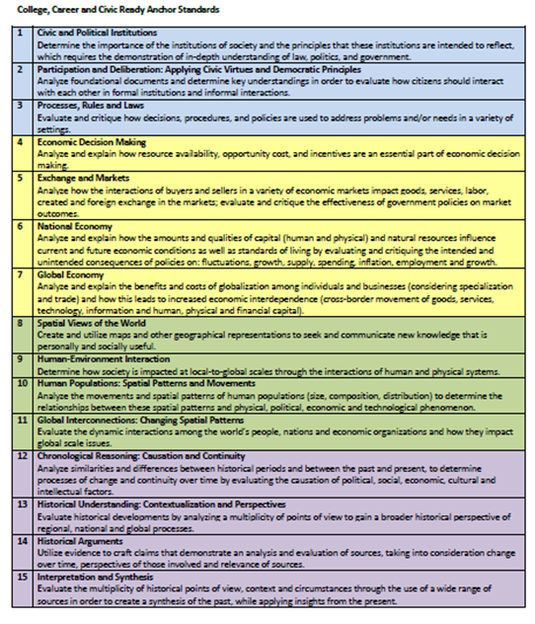
Critical Questions
In your assigned groups, generate questions using QFT process for the Anchor Standard you are assigned
Ask as many questions as you can.
Do not stop to answer, judge or discuss.
Write down every question exactly as it was stated. (Please number your questions.)
Change any statements into questions.
Closed-ended questions can be answered with a “yes” or “no” or with a one-word answer.
Open-ended questions require
more explanation.
Identify your questions as closed-ended or open-ended by marking them with a “C” or an “O”.
Notes:
Jennifer Carroll
ALL facilitate
12:45-1:30
Groups will be assigned anchors 1-8 and 10-15
Enter information into google docs

Slide 35
How to meet the challenges ahead …TOGETHER
WITHOUT TALKING
-form an EXPERIENCE LINE from newest to most EXPERIENCE in EDUCATION.
With your elbow partners discuss ….
How will this work …
Inform curriculum and instruction?
Impact assessment types/practices?
Formative assessment in the classroom
Summative classroom and state test
Guide Professional Learning?
Influence Professional Growth Goals?
Notes:
Jamee
After this discussion triads will form and have a standing meeting …

Slide 36
TRIADS REFLECTION
How will you share this process/work with other District Leadership Team members?
How will you share this process/work with other Social Studies teachers?
Notes:
Jamee
Form triads from experience lines and ask that each triad have one “idea” to share.

Slide 37
With your district SS team --- create a NEXT STEPS plan for your work
What and why does information/process need to be shared?
Who wants or needs the information?
What is most effective way to deliver information?
When can we most effectively share this information?
Notes:
Jennifer Carroll
2:30-3:00
Fill out your next steps sheet.
Consider what support you need.

Slide 38
Domain 1
Evidence: Can be seen, heard, or read
Domain 4
Notes:
For some who are in their summative year, they are preparing for their summative evaluation and they need to have evidence for Domain1 and Domain 4.
Collecting evidence for Domains 1 and 4.
Your work as a teacher leader impacts your professional practice. You learn new skills, information, and strategies to not only use in your own classroom but to share and build capacity around in your schools and district.
Domain 1 and 4 are domains that the teacher collects evidence around because the evidence is not usually evidence the principal or evaluator would see when doing an observation. It is important that teachers collect this evidence and share it with their evaluator during observation conferences or reviews.
Evidence should be quality-and probably can serve as evidence across components and domains.
.

Slide 39
Identify key evidence for the component that would define accomplished professional practice
1a 4a
1b 4b
1c 4c
1d 4d
1e 4e
1f 4f

Slide 40
Unpacking Your Day
Notes:
Carole 3:00 – 3:15
Reflection

Slide 41
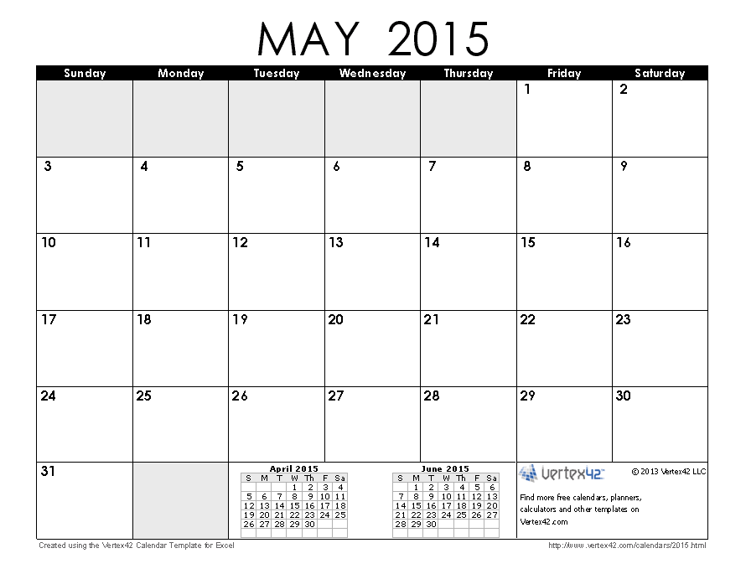
HCTC
First Federal Building
9:00-3:00
SSTLN

Slide 42
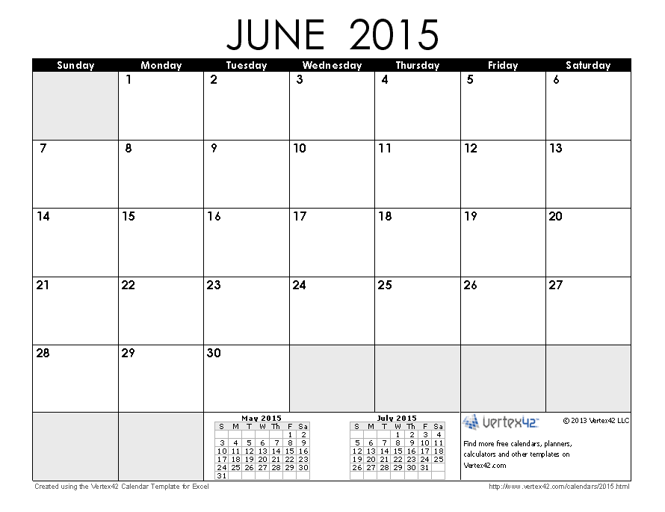
HCTC
First Federal Building
9:00-3:00
SSTLN

