Slide 1


Teaching Students to Ask Their Own Questions
Question Formulation Technique
(QFT)
Kim Sergent, KVEC Social Studies Instructional Specialist
kimberly.sergent@letcher.kyschools.us
Carole Mullins, KVEC Literacy Instructional Specialist
carole.mullins@hazard.kyschools.us
Notes:
Carole
Introductions

Slide 2


Build an Inquiry-Based Community of Students and Teachers
Notes:
Carole

Slide 3

Introduction to the Question Formulation Technique
Experiencing the QFT:
  Classroom Application
  Developing Specific Thinking Abilities
The Art and Science of the QFT
What’s the Connection? (KAS and KY FfT)
Next Steps
Notes:
Carole

Slide 4


Let’s find out what you know about the Question Formulation Technique?
www.plickers.com
Notes:
Kim and Carole
We want some instant feedback on your current knowledge about QFT…
Plickers is a new classroom polling system which can display results in real time. The only materials you'll need to get started are paper, a printer, and a smartphone or tablet.
Plickers allows teachers to tailor instruction with instant feedback
Plickers is a powerfully simple tool that lets teachers collect real-time formative assessment data without the need for student devices
Engage ALL students in critical thinking
Gives all students the chance to participate and engage in learning without feeling self-conscious.
Use Plickers for quick checks for understanding to know whether your students are understanding big concepts and mastering key skills

Slide 5
Traditional Classroom
Teachers ask
Students answer
Teachers explain
Students take notes
Teachers create
Students complete
Instruction and inquiry flow almost entirely in one direction…
From the teacher to the student
Notes:
Carole: Setting the Stage for today’s work…
Let’s begin by “reviewing” what currently happens in a traditional classroom,
the teacher is the center of attention, the owner of knowledge and information.
Teachers often ask questions of their students to gauge comprehension, but it’s a passive model that relies on students to absorb information they need to reproduce on tests
What do you think? Is the basic flow of education? Discuss with a partner…
We need to strive for a more balanced questioning diet, one that welcomes more questions from students

Slide 6

1
The teacher is usually the person who asks the questions during a discussion. In a longitudinal study of elementary and secondary school classes, Dillon (1990) found that each student asks only one question(s) per month on average. Teachers must take deliberate steps to get their students to ask questions.
Notes:
Kim
Ask participants to guess how often students ask questions.

Slide 7

Why is it worth the time and effort to encourage more student questioning?
The average preschool child asks 100 questions per day, but that number declines sharply when kids enter grade school.
By middle school, the number of questions the average child asks in a day approaches zero.
Why is there such a drastic decrease in the frequency of a behavior that seems to come naturally to most kids when they are very young?
Because like most adults, kids will do what they are rewarded for doing, and in school you are rewarded for having correct answers, not asking good questions.
Notes:
Kim
Being college and career ready is being able to ask good questions

Slide 8

The Development of the Question Formulation Technique
Notes:
Kim

Slide 9


LAWRENCE, MA, 1990
“We don’t go to the school because we don’t even know what to ask.”
Notes:
Kim: How it all started…
The idea for the Right Question Strategy (QFT) did not originate in a laboratory nor in an academic study
We began our work with a dropout prevention program in Lawrence, MA, funded by the Annie E. Casey Foundation, when parents told us they were not participating in their children’s education because they “don’t even know what to ask.”
Parents had identified a huge obstacle that prevents many people from thinking for themselves, from doing their own problem solving, from becoming more self-sufficient and from being able to see the “Big Picture” beyond their own lives.
Why, we wondered, was it so difficult for so many people to ask their own questions?
Dan’s Quote:
“It only took hearing that statement one or two…thousand times, and we finally got it. Eventually, we figured out that we had to find a way to teach people how to formulate their own questions. We’ve spent 20 years designing ways to do that as simply and effectively as possible and created the Question Formulation Technique (QFT).”
We saw that the most effective advocates for their families were the people whose questions focused on:
The process for making the decision
The role they could play in that process
And the reasons for the final decision-making processes that affect them
In field after field, in community after community, RQI’s educational strategy has been tested and proven particularly effective for engaging and building the skills of people who have rarely been active participants in key decisions that affect them.
Two factors that affect the success of QFT:
First, the original idea came from listening to the people who were not participating.
Second, they have worked hard to simplify, simplify and further simplify the process for teaching these very sophisticated skills.

Slide 10

KVEC QFT Cadre: Trendsetters

Slide 11

The Question Formulation Technique
What is it?
    QFT is a step-by-step process that helps students learn how to produce their own questions, improve them, and strategize on how to use them. The teacher’s role is simply to facilitate that process.
What is the purpose?
    QFT provides a deliberate way to help students cultivate a skill that is fundamentally important for all learning.
Notes:
Kim: Quick overview of “definition” of QFT
Using the QFT requires that students ask all the questions.
QFT can be used to introduce students to a new unit, to assess students’ knowledge to see what they need to understand better, and even to conclude a unit to see how students can, with new knowledge, set a fresh learning agenda for themselves. The technique can be used for all ages.
Teachers tell us that using the QFT consistently:
increases participation in group and peer learning processes
improves classroom management
enhances their efforts to address inequities in education

Slide 12

Education
An educator-led movement
100,000 educators using the strategy in 3 years
The Right Question Institute offers many of our materials through a
Creative Commons License and we encourage you to make use of and/or share this resource. Please reference the Right Question Institute
as the source on any materials you use.
www.rightquestion.org
Notes:
Kim
Each of you will receive a copy of this resource later in the day

Slide 13



How can we get more students to ask their own questions?
Can we make it easy(ier) for teachers to help make that happen?
Notes:
Kim
MAKE JUST ONE CHANGE: How can YOU make this change happen?

Slide 14
The Question Formulation Technique (QFT)
A rigorous process that helps all students learn to become more skilled question askers and problem-solvers
Distills best pedagogical practices into a simple teaching and learning process
Offers a shortcut to student engagement, ownership and deeper learning
Notes:
KIM
QFT 101 HANDOUT
Increases rigor in both teaching and learning
Also addresses KY requirements in standards and the framework… Carole will address this more specifically later in the day.

Slide 15
Students Learn To:
  Produce their own questions
  Improve their questions
  Strategize how to use their questions
  Reflect on what they have learned and how they learned it
Notes:
Kim

Slide 16
Question Formulation Technique as a FOUNDATIONAL SKILL
From a Big Idea to a Practical Resource
Designed to address the burdens on teachers to ensure that students can get to more of the right answers
Leads to positive changes in your classroom when students ‘own’ the questions and the learning agenda
Promotes a skill that is essential to both Academic and Life-Long Learning!
Notes:
Kim
Emphasize AGAIN before experiencing the QFT…

Slide 17
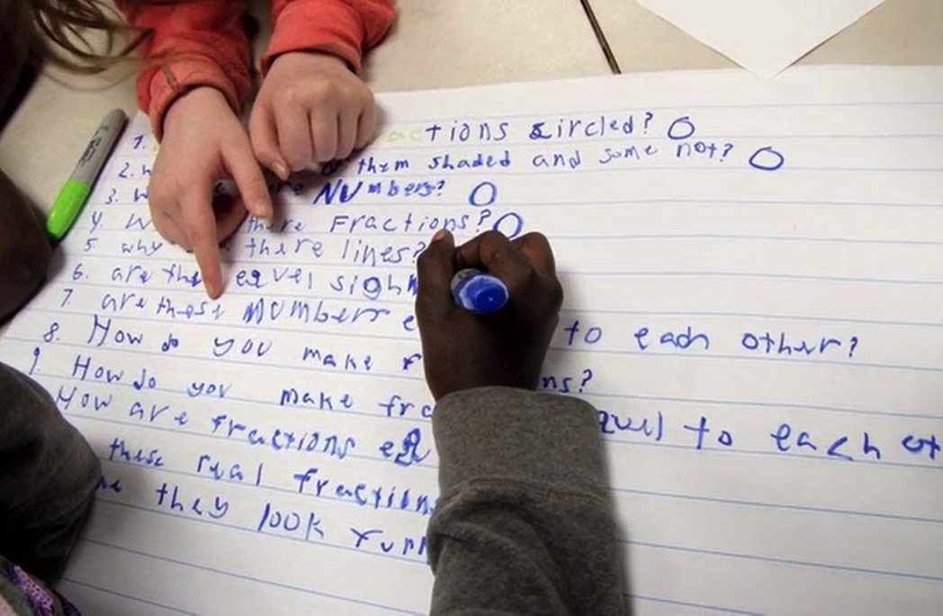
An Experience
with the Question Formulation Technique (QFT)
Notes:
Kim

Slide 18

Rules for Producing Questions
1. Ask as many questions as you can
2. Do not stop to answer, judge or discuss
3. Write down every question exactly as
stated
4. Change any statements into questions
Notes:
Kim HANDOUT
Table Tents

Slide 19
Question Focus
We must prepare our children for the 21st Century.
Notes:
Kim (Table Tents)
Q-focus

Slide 20
Producing Questions
We must prepare our
children for the 21st Century.
Recorder will write questions from the group on a sheet of paper
Each person must contribute 3 questions
Follow the rules as you work together:
      Ask as many questions as you can.
      Do not stop to answer, judge or discuss.
      Write down every question exactly as stated.
      Change any statements into questions.
Recorder will number the questions
Notes:
Kim: WHOLE GROUP
Group Recorder will write down questions on a piece of paper
Table Tents with rules
Producing Questions around the Q-focus

Slide 21
Categorizing Questions:
Closed/Open
Definitions:
  Closed-ended questions can be answered with a “yes” or “no” or with a one-word answer.
  Open-ended questions require more explanation.
Directions: Identify your questions as closed-ended or open-ended by marking them with a “C” or an “O”.
Notes:
Kim: Follow directions on slide

Slide 22
Improve Questions
Take one closed-ended question and change it into an open-ended question.
Take one open-ended question and change it into a closed-ended question.
CLOSED
OPEN
OPEN
CLOSED
Notes:
Kim
Ask participants to change questions from one type to another.

Slide 23
Prioritizing Questions
Review your list of questions
Choose the three questions you consider most important.
While prioritizing, think about your Question Focus:
After prioritizing consider…
Why did you choose those three questions?
Where are your priority questions in the sequence of your entire list of questions?
We must prepare our
children for the 21st Century.
Notes:
Kim
DISTRIBUTE CHART PAPER AND MARKERS
AFTER PRIORITIZING IS COMPLETE: Write your 3 priority questions on chart paper
K-5: Best questions usually occur towards the end of their list. The more questions students ask, the better they get!
6-12: Best questions will happen anywhere! It depends on the individual students.

Slide 24

Share
Questions you changed from open/closed
Your three priority questions and their numbers in your original sequence
Rationale for choosing priority questions
What you will do with the questions
Notes:
Kim

Slide 25
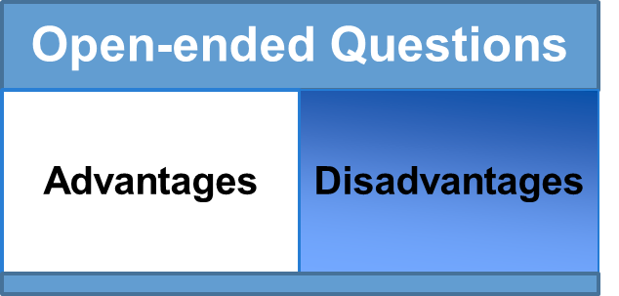
Discussion
Advantages
Disadvantages
Closed-ended Questions
Notes:
Kim (GROUP HANDOUT)
WHOLE GROUP DISCUSSION AND CHARTING ACTIVITY

Slide 26

Time for Reflection
What did you learn?
What do you understand differently now about the problem of students not asking questions?
Notes:
Kim

Slide 27

Unpacking the QFT Process and Outcomes
Notes:
Carole
I’m going to begin this portion of the training by identifying the important skills required in our standards and KY FfT that QFT addresses…

Slide 28

Three Thinking Abilities in One Process
  Divergent
  Convergent
  Metacognitive
Notes:
Carole

Slide 29
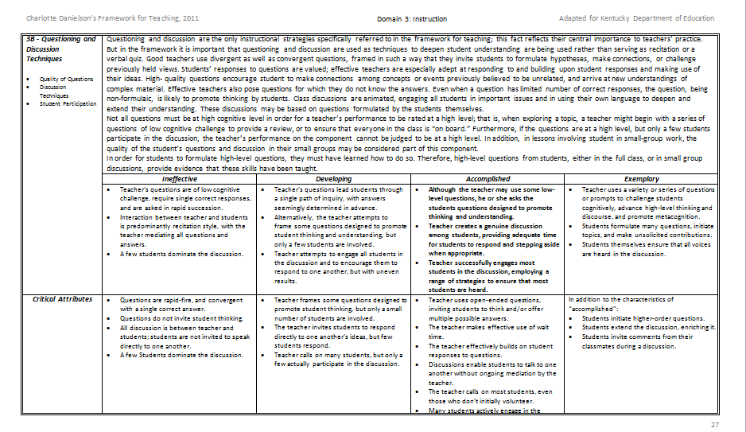
Domain 3: Instruction
3b – Questioning & Discussion Techniques
Notes:
Carole: Framework 3b: HANDOUT
Let’s begin by looking at the KY FfT… We will focus on the summary and descriptors
Instructions:
4 minutes to read the identified sections and locate information related to rigor!

Slide 30

Critical Attributes
In addition to the characteristics of accomplished:
  Students initiate higher-order questions.
  Students extend the discussion, enriching it.
  Students invite comments from their classmates during discussion.
Notes:
Carole
Look at the critical attributes on the back side of 3b. These are the distinguishing characteristics among the 4 categories.
Accomplished and Exemplary: Clearly critical attributes of best practice have students initiating and leading the classroom.
High-quality questions encourage students to make connections among concepts or events previously believed to be unrelated, and arrive at new understandings of complex material. Effective teachers also pose questions for which they do not know the answers. Even when a question has limited number of correct responses, the question, being non-formulaic, is likely to promote thinking by students. Class discussions are animated, engaging all students in important issues and in using their own language to deepen and extend their understanding. These discussions may be based on questions formulated by the students themselves.
(Not all questions must be at high cognitive level in order for a teacher’s performance to be rated at a high level; that is, when exploring a topic, a teacher might begin with a series of questions of low cognitive challenge to provide a review, or to ensure that everyone in the class is “on board.” Furthermore, if the questions are at a high level, but only a few students participate in the discussion, the teacher’s performance on the component cannot be judged to be at a high level. In addition, in lessons involving student in small-group work, the quality of the student’s questions and discussion in their small groups may be considered part of this component.)
IN ORDER FOR STUDENTS TO FORMULATE HIGH-LEVEL QUESTIONS, THEY MUST HAVE LEARNED HOW TO DO SO. THEREFORE, HIGH-LEVEL QUESTIONS FROM STUDENTS, EITHER IN THE FULL CLASS, OR IN SMALL GROUP DISCUSSIONS, PROVIDE EVIDENCE THAT THESE SKILLS HAVE BEEN TAUGHT.
POSSIBLE EXAMPLES SECTION, TOO.

Slide 31
Thinking in many different directions: Moving from CLOSED to OPEN QUESTIONS
DIVERGENT
THINKING
Notes:
Kim
Visuals to help further understand

Slide 32
Narrowing Down, Focusing
Moving from OPEN to CLOSED
CONVERGENT
THINKING
Notes:
Kim
This type of question is NOT dummying down the content!!!!

Slide 33

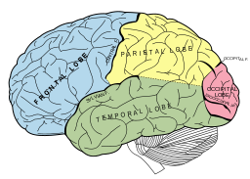
Thinking about Thinking
METACOGNITIVE
THINKING:
“Why did
you pick those as
your priority
questions?”
Notes:
Kim

Slide 34

Students:
Feel differently…
  Students feel more confident.
  Students express greater interest and are more curious.
  Students feel a greater sense of urgency and responsibility to get the answers.
  Behave differently…
Students self-regulate more effectively.
Students collaborate and listen to each other’s questions.
Students negotiate and work on reaching
consensus about group decisions.
Notes:
Kim
Once the three thinking abilities of divergent, convergent and metacognition are activated GREAT things/changes begin to happen!!
Curiosity
Engagement
Ownership
Deeper learning

Slide 35

Notes:
10:40-50

Slide 36

Exploring Classroom Examples
Notes:
Kim

Slide 37

Classroom Example: Kindergarten, Non-Fiction Literacy
Teacher: Jay Corrigan, Frederick County, MD
Topic: Alligators
Purpose: Pre-reading hook; get students ready to think about a non-fiction text they were going to read about alligators
Notes:
Kim

Slide 38

Question Focus
Notes:
Kim
Carole: Chart Teacher Questions

Slide 39

Student Questions
Is the alligator camouflaged?
Why do the babies have stripes?
Are those baby crocodiles?
Is it a mom or dad crocodile?
What is the green stuff?
Why are they in the water so low?
Where are they going?
Why are the baby alligator’s eyes white and the mom’s black?
Why are baby alligators on top of the momma alligator?
Why does momma or daddy have bumps on them?
Notes:
Kim

Slide 40
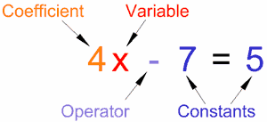
Classroom Example:
Fourth Grade Math
Teacher: Deirdre Brotherson, Hooksett, NH
Topic: Variables
Purpose: Introduce variables to students
Notes:
Kim
Carole: Distribute index cards

Slide 41
Question Focus
24 = ☺ + ☺ + ☺
Notes:
Kim
Index Card Prioritization Activity

Slide 42
Student Questions
Why is the 24 first?
What do the smiley faces mean?
Why are there 3 smiley faces?
How am I suppose to figure this out?
Is the answer 12?
Can I put any number for a smiley face?
Do the numbers have to be the same because the smiley faces are the same?
What numbers will work here?
Does it mean 24 is a really happy number?
Can we replace each smiley face with an 8?
Do any other numbers work?
Can we do this for any number?
Does it always have to be smiley faces?
Do we always have to use three things?
Notes:
Kim

Slide 43

Classroom Example:
Middle School
Teacher: Megan Harvell, Boston, MA
Topic: American History
Purpose: Pre-reading activity to engage students
Notes:
Kim

Slide 44
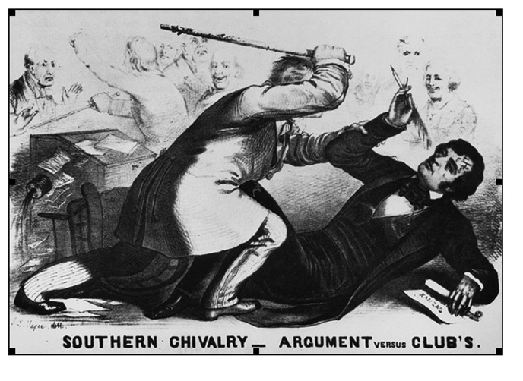
Question Focus
Notes:
Kim
2-3 minutes individually produce questions
1-2 minute individual prioritization
2-3 minute table prioritization

Slide 45

Student Questions
Why are they fighting?
Are they fighting?
Are they part of the government?
Where were they?
Who are they?
Were they signing anything?
Who else was there?
Why are you hitting him?
Why didn’t they call 911?
Was this related to slavery?
Why is he hitting him with a bat?
Why are you taking a pen?
Why are they in court?
Who hit who first?
Who died?
Why are they smiling?
Notes:
Kim
Review of sample student responses

Slide 46

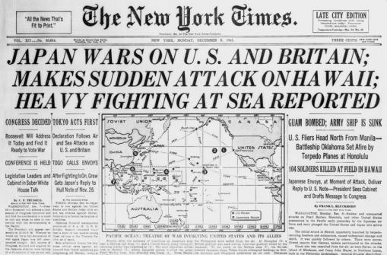
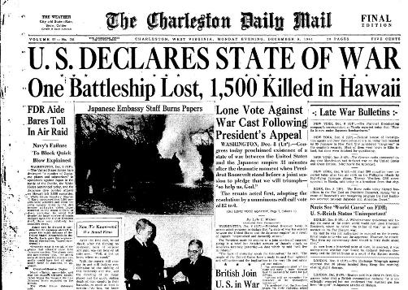
Experience a Social Studies Lesson Using the Question Formulation Technique (QFT)
Notes:
Kim: Give Instructions and Lead Activity
Distribute Reader’s Theatre Cards and provide instructions
Carole: Handle
Change to Pearl Harbor PPT
Use “Sad War Songs” audio and “FDR Day of Infamy” speech

Slide 47

12:00-12:45
Notes:
Carole
Give MAKE JUST ONE CHANGE book. Read Chapter 9 first!

Slide 48
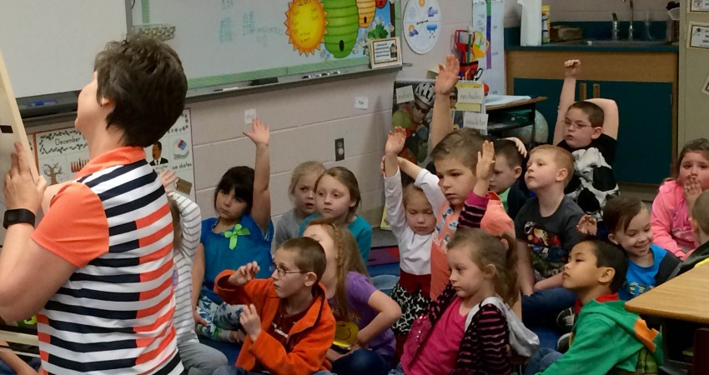
The QFT In Action
https://vimeo.com/1607997577
Notes:
KIM

Slide 49

QFT: A Teacher’s Perspective
Making That Change
Notes:
Kim

Slide 50

My Planning Steps
Goal(s) for this QFT: stimulate new thinking, deepen comprehension
AP US History: Slavery – 8 day mini-unit
Linked to 5 of the APUSH Themes
I chose a visually-stimulating Q-focus with aural support
3-4 minute power point of primary sources (images) set to a spiritual
Students’ questions become supporting questions for the mini-unit
Notes:
Kim

Slide 51
QFT: How Did Students Respond?
In the beginning:
By the end of class:
Unsure of what I wanted
Reluctant to share
Preoccupied with having the right answer
Excited to learn what they wanted to know
Connected to the topic
Empowered by choice and relevance
Notes:
Kim

Slide 52

Relevance: Student Choice
The process creates a natural atmosphere for inquiry.
Within each step, students are given the opportunity to engage in curiosity.
Students own the inquiry.
Develop a responsibility not only to the learning, but to each other in the process.
Notes:
Kim

Slide 53

An Important Step: Prioritization
Rigor embedded in the process
Students thinking about thinking-
Their own thinking
Linking to others’ thinking
Connects the inquiry to the Q-focus, which…
Connects to the content, which…
Connects to the standard
Notes:
Kim

Slide 54
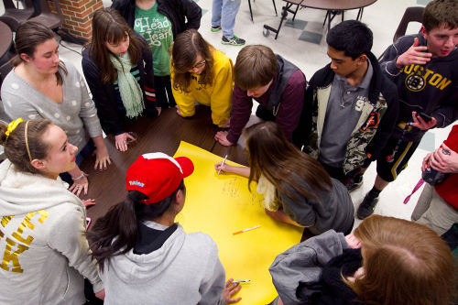
A Teacher’s Parting Thoughts…
Trust the process!
Let go and let them do the work.
Notes:
Kim

Slide 55

The Art and Science of the QFT
Notes:
Kim

Slide 56

QFT: An ART and a SCIENCE
The Science:
A rigorous protocol, with specific steps and sequence, that produces consistent results
The QFT
Discuss the rules
Present a Question Focus
Improve questions
Prioritize questions
Discuss next steps
Reflect
Notes:
Kim

Slide 57

QFT: An ART and a SCIENCE
The Art:
Tailoring the QFT process to the specific content and students you are teaching.
Tailor the QFT through:
Design of the QFocus
The instructions for prioritizing
The next steps for using the questions
The reflection
Notes:
Kim

Slide 58

  How will you use QFT next school year?
Notes:
Kim
Introduction Slide to Brainstorming Activity explained on next slide…

Slide 59

QFT in Your Classroom
Identify a lesson or unit that…
-is new to your curriculum
-doesn’t excite your students, or you!
-seems long or starts to stretch out as you engage in the unit
Notes:
Kim
3 minute Table Brainstorming Instructions

Slide 60

Backwards Planning
Notes:
Kim

Slide 61

QFT Planning Tool
Takes you step by step through the components of QFT that the teacher directs, the art.
Notes:
Kim HANDOUTS: QFT Planning Tool (YELLOW) and QFT Cheat Sheet (WHITE)
teaching goals
Determine question use (next steps)
Design a QFocus
Develop prioritization instructions
Create reflection questions
Plan facilitation

Slide 62
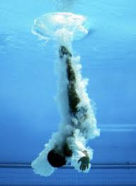
  Dive into the planning tool on your own or with a partner.
Notes:
Kim HANDOUTS (Cheat Sheet)
Work with the planning tool to create own QFT
Here’s an additional “cheat sheet” Handout

Slide 63

The Art of the QFT: Teacher Practice and Procedure
Development of a Q-Focus
Prioritization
Facilitation
Reflection
Notes:
KIM
Introduction slide for practicing the teacher art of QFT

Slide 64
Part 1: Question Focus (Q-Focus)
A Question Focus IS a simple statement, a visual or aural aid to help students generate questions
    Created from curriculum content
    Brief
    Stimulates a new line of thinking
A Q-Focus is NOT
    A question
Notes:
Kim
REFER TO SECTION OF PLANNING TOOL ON Q-FOCUS
Because the Q-Focus is such an important part to “get right” when conducting QFT. I want you to have a basic understanding of what the Q-Focus entails…
A QFT lesson always begins with a “Q-Focus”.
The Question Focus (Q-Focus) is a prompt presented in the form of a statement, visual/audio aid, short text, etc. and designed to attract students’ attention and stimulate the formation of questions. Review information on slide.

Slide 65
Part 2: Prioritization
“The act of prioritization – the ability to assign importance property – is an intellectual task involving a wide range of skills, including comparison, categorization, analysis, assessment and synthesis.”
Make Just One Change: Teach Students to Ask Their Own Questions
Rothstein and Santana, Page 88.
Notes:
Kim
Critical Thinking Skills Students Need to Be College and Career Ready.

Slide 66

Part 2: Prioritization
EXAMPLES
Choose three questions that:
  you consider most important
  will best help you design your research project
  will guide your writing
  that you want answered as you read/research
  are the most “testable”
  could help you identify possible obstacles
Notes:
Kim
“YOU” keeps us honest with fidelity!

Slide 67
Part 3: Facilitation
The facilitation of the process can be modified to meet the needs of your students and your classroom.
Modifications for Young Learners
Other Modifications
Flash card prioritization
Color code key
Dedicated recorder
Whole group produces questions
Variety of Q-Focus for different groups
Advanced Prioritization
    Compelling and supporting questions
Technology
    Google docs
    Voice to text (evernote + iPad)
Notes:
Kim

Slide 68
Part 4: Reflection Questions
The Student Reflection process allows for integration of the learning and the ability for students to understand the QFT process for future application.
QFT Process
Content Specific
How did you learn it?
What do you understand differently now about asking questions?
How can you use what you learned about asking questions?
How do you feel about asking questions?
How did the QFT process help you think about…
  a key concept
  a specific assignment
  an overarching topic
  a theme in the unit, a chapter you just read
Notes:
Kim

Slide 69
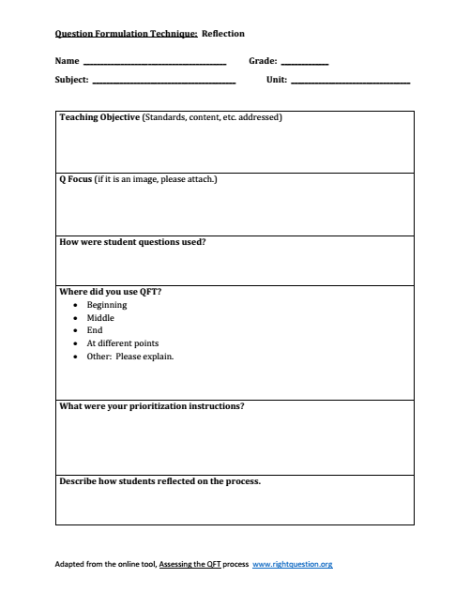

Reflection
Completed Individually… Discussed in Pairs or PLCs
Notes:
Kim HANDOUT FOR TEACHER ONLY!!
Completed Individually; Discussed in Pairs or PLCs

Slide 70

Notes:
Carole
Why QFT is such an important Foundational Skill for Academics and Life-long Learning!

Slide 71

The Research Confirms the Importance of Student Questioning
Self-Questioning (metacognitive strategy):
Students formulating their own questions proved to be one of the most effective metacognitive strategies
Engaging in pre-lesson self-questioning improved students rate of learning by nearly 50% (Hattie, p.193)
Visible Learning: A Synthesis of Over 800 meta-Analyses Relating to Achievement by John Hattie. 1st Edition, December 26, 2008.
Notes:
Carole
John Hattie’s latest book is entitled Visible Learning for Teachers…

Slide 72
A Movement Towards Inquiry-Based Learning
Kentucky Framework for Teaching
Kentucky Academic Standards (KAS)
Program Reviews
College, Career, and Civic Life (C3)
Framework for Social Studies
Notes:
Carole
Connections to KY educational requirements

Slide 73

KAS for English/LA and Literacy in the Content Areas
What is the Connection?
Notes:
Carole: KAS/QFT HANDOUT
Give each table a Standard Section, Discuss where this happened in the QFTs you experienced today… Share out
Review standards connections that are evident for ALL content areas
Important part of lesson planning and inquiry-based learning is collaboration and integration of Literacy Skills!

Slide 74


QFT can be used effectively before, during and after instruction.
Beginning of Instruction
Middle of Instruction
End of Instruction
Students ask questions about previous instruction to guide a class discussion or Socratic Seminar
Teacher uses student questions to shape or refine lesson plans for the next day or entire unit
The teacher references student questions from the beginning of a unit to see how questions are being answered
Students generate questions to design their own homework assignments
Students use questions to prepare for assessment(s)
Students use questions to design final products
The teacher uses the QFT to review learning that occurred during a unit to prepare for assessment
Notes:
Kim
At this point students and teachers can work together to determine how to use the questions they selected.

Slide 75
Let’s find out what you learned about the Question Formulation Technique today!
www.plickers.com
Notes:
Kim and Carole
We want instant feedback to check on what you learned today! ANSWER SAME QUESTIONS FROM THE PRE-SURVEY THIS MORNING
Plickers is a new classroom polling system which can display results in real time. The only materials you'll need to get started are paper, a printer, and a smartphone or tablet.
Plickers allows teachers to tailor instruction with instant feedback
Plickers is a powerfully simple tool that lets teachers collect real-time formative assessment data without the need for student devices
Engage ALL students in critical thinking
Gives all students the chance to participate and engage in learning without feeling self-conscious.
Use Plickers for quick checks for understanding to know whether your students are understanding big concepts and mastering key skills

Slide 76

Final words:
UNIVERSAL RELEVANCE
Notes:
Kim

Slide 77

KVEC/ARI
QFT Cadre Follow-Up Sessions
September 19, 2016
Hazard Community & Technical College
One Community College Drive
Hazard, KY 41701
November 14, 2016
KVEC Training Center
412 Roy Campbell Drive
Hazard, KY 41701

Slide 78
How to Access Resources from Today’s Training:
Click on the “QFT June 2016” tab at:
www.kvecelatln.weebly.com
OR
www.kvecsstln.weebly.com
For additional QFT resources and the latest
information, please visit: www.rightquestion.org

