Slide 1
Questions that matter in the social studies classroom.
Crafting
Notes:
Now that we have a better understanding of QFT, let’s start thinking about what it could look like in our classrooms. If you recall, the proposed inquiry practices begin with questioning. This practices sets out a vision that students and teachers would be co-constructing questions suitable for inquiry. While students would be asked to practice writing questions, we know that teachers’ questions will likely guide curricular decisions. What is crucial is that students understand the questions under investigation; questions can’t live on a whiteboard or up on a wall or worse, in just a lesson plan—these questions cannot be ornamental, but rather they need to live in the classroom. The hope or intent is that an instructional space would be created that would allow students to explore the questions and to build a series of questions (supporting questions) to guide the inquiry.

Slide 2
Remembering Pearl Harbor
(Franklin D. Roosevelt Library, NLR-PHOCO-A-8150(29))

Slide 4
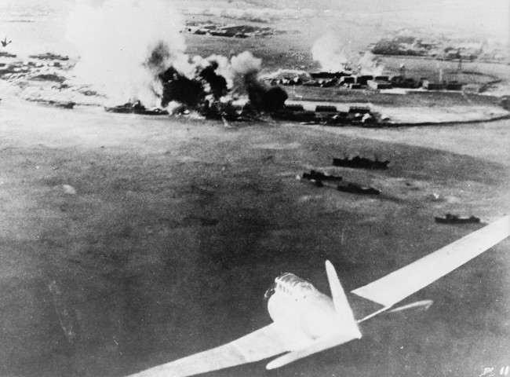

Slide 5
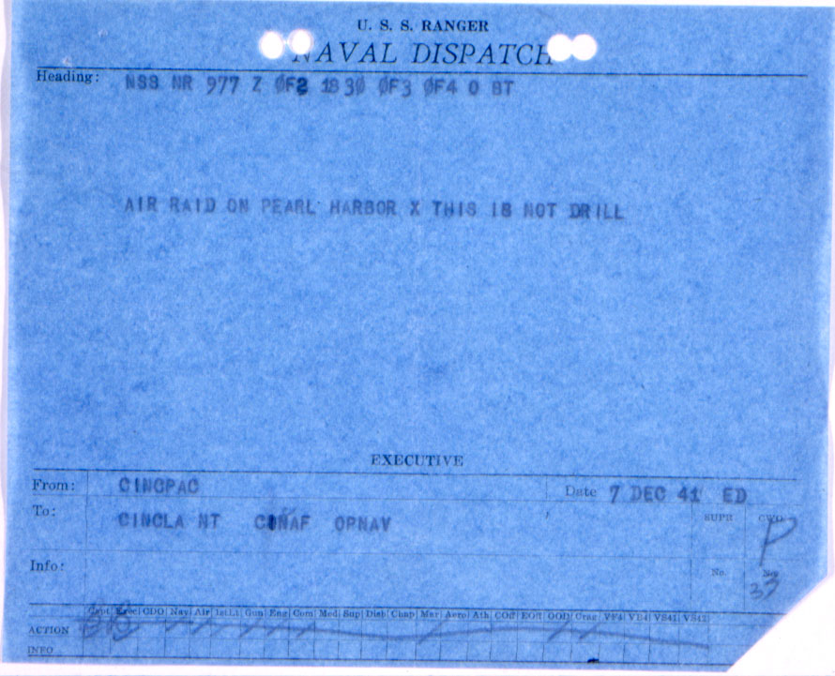

Slide 8
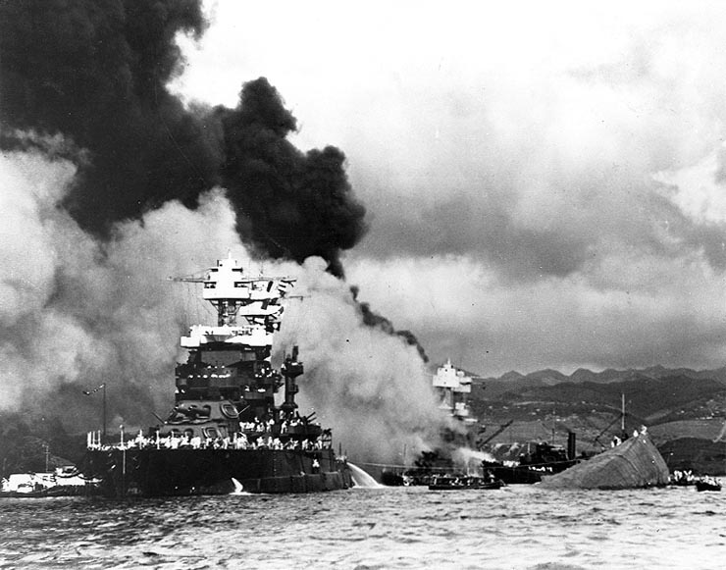

Slide 12
Producing Questions – 4 min.
Ask Questions
Remember the Q-Focus
Number the Questions
Notes:
They’ll ask questions independently for 4 minutes.

Slide 13
Categorizing Questions: Closed/Open
Definitions:
Closed-ended questions can be answered with a “yes” or “no” or with a one-word answer.
Open-ended questions require
more explanation.
Directions: Identify your questions as closed-ended or open-ended by marking them with a “C” or an “O”.

Slide 14
Change Closed to Open -Ended Questions (Divergent Thinking)
Directions: Take one closed-ended question and change it into an open-ended question
CLOSED-ENDED
OPEN-ENDED

Slide 15
Change Open to Closed -Ended Questions (Convergent Thinking)
Directions: Take one open-ended question and change it into an closed-ended question
OPEN-ENDED
CLOSED-ENDED

Slide 16
Prioritizing Questions
Review your list of questions
Choose the three questions you consider most important
While prioritizing, think about your Q-Focus:
*Pictures and captions
*Roosevelt’s “Day of Infamy” speech

Slide 17
Share
Your three priority questions and their numbers in your original sequence.
Rationale for choosing priority questions.
THEN:
Create a TABLE LIST of QUESTIONS from your shared priority questions.

Slide 18
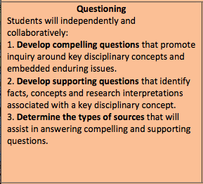
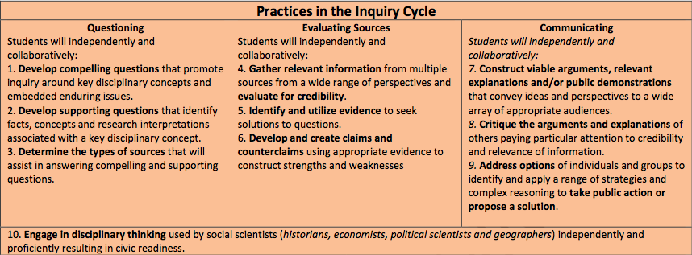
Connections
Connecting Question Formulation Technique to the Inquiry Practices

Slide 19
Compelling Questions
Address problems and issues found in and across the disciplines;
Require students to apply to disciplinary concepts and skills;
Require students to construct and argument;
Compelling questions emerge from students’ curiosities;
Grounded in curriculum and content.
Notes:
Let’s review the purpose of compelling and supporting questions.

Slide 20
Questions for compelling questions.
Will the question get under kids’ skin?
Is it interesting?
Is there a way to engage students in this question?
Is the question full of curricular jargon? Is the question vague or obtuse?
Is there bias? Is there room for argument?

Slide 21
Examples of compelling questions.
Am I rich?
What color am I?
Does the color of our skin matter?
Why do we have rules?
Why can’t I say that?
Why are we still reading Lincoln?
How bad was the recession?
Where are we?
Can the US and Canada be friends forever?
Why is Frankfort the capital of Kentucky?
Who won the Cold War?
Was the Civil Rights Movement of the 1960’s a success?

Slide 22
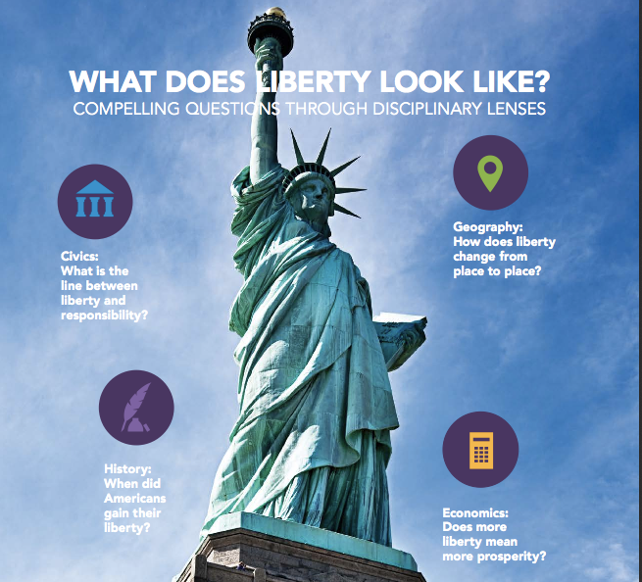

Slide 23
Compelling versus Essential
Notes:
How many of you have been using essential questions in your classrooms?
How do you define an essential question?
Jay McTighe and Grant Wiggins state that EQs are used to stimulate students’ discussions and promote a deeper understanding of the content. They also state that EQs should embed or initiate inquiry-based learning in the classroom.
Are compelling questions that different from essential questions? The authors of the C3 would say no… call them what you will. A good question is a good question.

Slide 24
Supporting Questions
Contribute to understanding of compelling question;
Focuses on descriptions, definitions, and processes;
General agreement in the field;
Require students to construct an explanation;
Grounded in curriculum and content.
Notes:
Supporting questions often nestle underneath compelling questions.

Slide 25
Question Examples
Compelling Question:
What path should the transcontinental pipeline take?
Supporting Question:
What are the five largest sources of oil for U.S. Markets?

Slide 26
Questions Examples
Compelling Question:
Was the American Revolution Revolutionary?
Supporting Question:
What were the regulations placed on the colonists under the Townsend Acts?

Slide 27
Questions Examples
Compelling Question:
Should our community grow?
Supporting Question:
Who are community helpers?

Slide 28
Back to your questions……
***Which questions at your table are the most likely candidates for compelling questions?
Supporting questions?
Notes:
Now that we have reviewed, let’s go back to our table lists …

Slide 29
QFT and Compelling Questions and Supporting Questions
WRAPPING UP OUR EXPERIENCE
How do I generate a Question Focus that will allow students to generate compelling and supporting questions?
Try considering what disciplinary concerns or ideas might be associated with the question that could be open to different interpretations.
Notes:
A question focus is a simple statement, a visual or aural aid to help students generate questions.

Slide 30
Inquiry Practices and Questioning
Students will independently and collaboratively:
3. Determine the types of sources that will assist in answering compelling and supporting questions.
Notes:
We’re still not done with questioning. Questions are fundamental for ASSESSING the validity of sources. For example, do we use a source from the Library of Congress or from “The Enquirer?”

Slide 31
Questioning in the Inquiry Practices
DISCUSSION
As a group, discuss 3-4 examples of sources that could assist students in answering our compelling question: Did the Pearl Harbor attack create a unified American nation?
Notes:
Let’s give this some thought and share some of our ideas.
In practice, this would allow students the opportunity to really begin their inquiries; however, for our purposes today, this is a good stopping point.

Slide 32
QFT Connections to KCAS for Social Studies
Questions are fundamental at
EVERY STAGE in the Inquiry Cycle.
Questioning: developing compelling and supporting questions
Evaluating Sources:
gathering information, identifying evidence, developing claims
Communicating:
constructing arguments and taking informed action
Notes:
Questioning: QFT can help to determine the kind(s) of content students need in order to develop their inquiries.
Evaluating Sources: QFT can help to assess the validity of sources.
Communicating: QFT can help to determine the purpose or viability of communicating or taking action.

Slide 33
Preparing to Use the QFT
Begin thinking about how you can incorporate QFT into an upcoming unit of study.
Notes:
Use the last 15 minutes of the breakout session to begin work on:
Preparing to Use the QFT – Distribute handout
Instruct TLs to begin work on Page 1. We will work some more after lunch…

Slide 34
LUNCH
12:15 – 1:00 p.m.

