Slide 1


Social Studies
Teacher Leader Network
March 28, 2014
Welcome!
www.kvecsstln.weebly.com
Notes:
Carole

Slide 2

Let’s Get Started!
Design a Name Plate that will be used at every Social Studies Network Meeting
Be sure to include the following information:
  Your Name (Make first name large)
  Name of District and School
  Grade Level and Subject/Course Taught
Be Creative!!
Notes:
Carole
Bellringer as TLs arrive and “settle in”

Slide 3

Facilitators for Today
Carole Mullins
KDE/KVEC Instructional Specialist
Mary McCloud
KVEC Literacy Consultant
Linda Holbrook
KDE Literacy Consultant
Jennifer Carroll
KDE/KVEC Professional Growth and Effectiveness
System Consultant
Notes:
Carole

Slide 4

  Norms
  February Evaluation
  Silent Conversation Results
  Network Update
  C3 Instructional Shifts Update
Notes:
Carole
Norms: Handout for notebook and slide
February Evaluation Report: Use my notes
Silent Conversation:
Majority concerned about how/when will be able to share with other SS teachers in your district. ISLN informed.
#2 was the amount of information you received and how you will remember it.
Network Update: Sent March 2014 SS Update to you via email and it is posted on our website
C3 Instructional Shifts Update
5 Major Instructional Shifts Identified in the C3
Feedback is due March 24th and then the C3 developers hope to have a “final” draft by April 1 to share

Slide 5
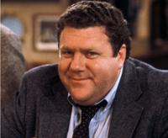
Civic Dispositions
NORMS!
“When once the forms of civility are violated, there remains little hope of return to kindness or decency.”
-Samuel Johnson
Notes:
Carole (Handout)
Review norms created at 1st meeting.

Slide 6
Today’s Agenda
Today’s Learning Targets
Leadership
Revisit “Reading Like A Historian”
Connecting C3 Framework and TPGES
  Break
Assessment Literacy
  LUNCH (Move to Grade Level Tables)
KCAS and Highly Effective Teaching and Learning: Literacy Stds. in History/Social Studies
  Break
Grade Level Group Sessions:
  C3 Inquiry Arc and Effective Questioning
  C3 Framework: Dimension 1
Notes:
Carole
Walkthrough Agenda

Slide 7

TARGETS FOR TODAY:
Further explore the role of Teacher Leadership.
Analyze connections between C3 Framework implications for teaching and the KY Framework for Teaching.
Analyze connections between Assessment Literacy and PGES to further understand Balanced Assessment.
Describe how KCAS (Literacy in History/SS) supports highly effective teaching and learning in Social Studies.
Recognize that the use of effective questions (compelling and supporting) are foundational to the C3 Inquiry Arc.
Analyze the structure and intent of the C3 Framework for Social Studies Inquiry Arc and Dimension 1.
Notes:
Carole
REMIND ABOUT EVALUATION FORM IN FOLDER!

Slide 8

Characteristics of the “Right”
Network Participants
Compare your list of characteristics with the handout. Highlight any that are similar.
Using another color of highlighter, identify any characteristic(s) that you wish to grow/improve through participation in the network.
Choose ONE bullet from your identified “grow list”. Write it on a post-it note and attach to the Wall Chart.
Notes:
Mary
Debrief from February Meeting:
What are strengths we have as a group?
How can we assist one another?
What are some things we may need to focus on?

Slide 9
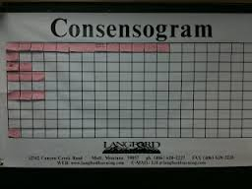
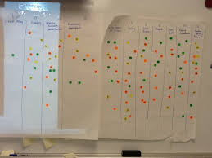
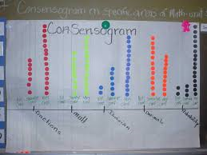
Consensogram
At the heart of the inquiry process is the use of data.
Notes:
Mary

Slide 10
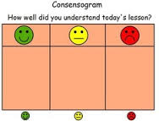
Consensogram
A Consensogram is a simple, quick, kinesthetic, engaging, and inquiry-based whole-group approach used to gather large quantities of student opinion and attitude data about an issue.
Using one large poster, or area of the whiteboard, students respond to a question by placing a marker (a sticky note, a dot, a star, etc.) above the response that best fits them.
By having all the students' responses in one place, it is possible to visually observe the range and draw conclusions from the data.
Notes:
Mary

Slide 11

Top 5 “Grow List”
Pedagogical
Content Knowledge
Creative
Willing to take Risks
Planning and organizing
Out of Box Thinking
Lead a Professional Learning Team
Notes:
Mary

Slide 12

Revisit Reading Like A Historian
Materials Needed: “Thinking Partners” Handout and
Your Completed Homework.
Discussion Schedule:
  5 minutes with a District Team Member
  5 minutes with someone from “Same Content/Grade Level” list
  5 minutes with someone from “Push My Thinking” list
  Back to your District Team for a 5 Minute AHA! Discussion
  TIP: Use your journal to take notes and/or
  gather ideas from others!
Notes:
Mary

Slide 13

Building Capacity Around the 4 Pillars
Notes:
Jennifer

Slide 14

Four Pillars of Network Meetings
Kentucky’s Core Academic Standards
Characteristics of Highly Effective Teaching and Learning/KY Framework for Teaching
Assessment Literacy
Leadership
Notes:
Jennifer
While we have four pillars or areas for our network meetings, it is hard to talk about one without making connections to the others.
Today we are going to look at assessment literacy.
Assessment literacy is naturally intertwined with the standards since student attainment of standard is what is assessed when we assess for learning and of learning….
We are going to look specifically today at how assessment literacy is embedded in the Kentucky Framework for Teaching.

Slide 15

Unbridled Learning and KBE Goals
All Kentucky students taught by a highly effective teacher and all Kentucky schools led by highly effective principals.
Notes:
Jennifer
Common statewide growth and effectiveness system

Slide 16

KENTUCKY’S FRAMEWORK FOR TEACHING
Notes:
Jennifer
Request participants to pull out this document from their notebook for use

Slide 17

Think about a “good” teacher you have had….
What did that teacher do that made them “good?”
Jot down some examples on separate post its
Examples
Notes:
Jennifer

Slide 18
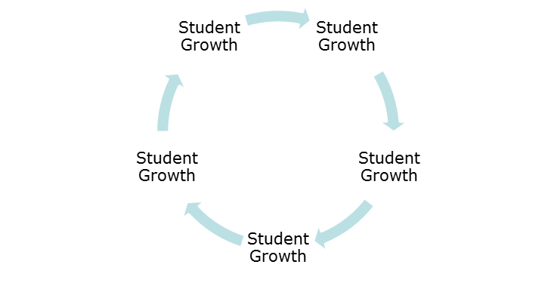
Framework for Teaching
Domain 1: Planning and Preparation
Demonstrating Knowledge of Content and Pedagogy
Demonstrating Knowledge of Students
Setting Instructional Outcomes
Demonstrating Knowledge of Resources
Designing Coherent Instruction
Designing Student Assessments
Domain 2: The Classroom Environment
Creating an Environment of Respect and Rapport
Establishing a Culture for Learning
Managing Classroom Procedures
Managing Student Behavior
Organizing Physical Space
Domain 4: Professional Responsibilities
Reflecting on Teaching
Maintaining Accurate Records
Communicating with Families
Participating in a Professional
Community
Growing and Developing Professionally
Showing Professionalism
Domain 3: Instruction
Communicating with Students
Using Questioning and Discussion
Techniques
Engaging Students in Learning
Using Assessment in Instruction
Demonstrating Flexibility and Responsiveness
Notes:
Jennifer (Handout) Framework for Teaching Quadrants
Looking at this graphic organizer of the Framework for Teaching, can you place each of your post its into a quadrant?

Slide 19
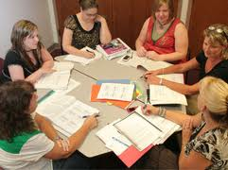
Share organizer results with your table:
What were the examples of good teaching?
How did they fit into the quadrants?
Why did you place them where you did?
Were there any quadrants not covered at your table?
Notes:
Jennifer

Slide 20
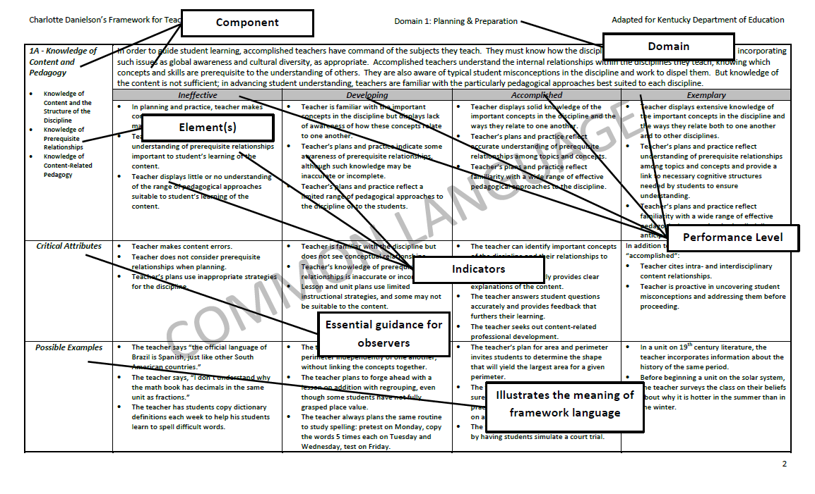
Notes:
Jennifer
Remind participants of the language to describe the framework. Domain and Component

Slide 21

Defining Effective Teaching
Two basic approaches:
Teacher practices, that is, what teachers do, how well they do the work of teaching
Results, that is, what teachers accomplish, typically how well their students learn
Notes:
Jennifer

Slide 22

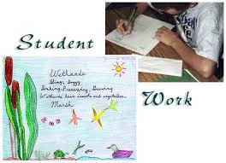
Based on Evidence:
Observations
Artifacts
Notes:
Jennifer

Slide 23

Looking at Evidence….
Using sample evidence from the Rosa Parks lesson:
Identify the Domain represented
Identify the Component represented
Notes:
Jennifer (Handout) TPGES-Rosa Parks Activity

Slide 24
What Domains/Components were Represented?
Domain 1: Planning and Preparation
Demonstrating Knowledge of Content and Pedagogy
Demonstrating Knowledge of Students
Setting Instructional Outcomes
Demonstrating Knowledge of Resources
Designing Coherent Instruction
Designing Student Assessments
Domain 2: The Classroom Environment
Creating an Environment of Respect and Rapport
Establishing a Culture for Learning
Managing Classroom Procedures
Managing Student Behavior
Organizing Physical Space
Domain 4: Professional Responsibilities
Reflecting on Teaching
Maintaining Accurate Records
Communicating with Families
Participating in a Professional
Community
Growing and Developing Professionally
Showing Professionalism
Domain 3: Instruction
Communicating with Students
Using Questioning and Discussion
Techniques
Engaging Students in Learning
Using Assessment in Instruction
Demonstrating Flexibility and Responsiveness
Notes:
Jennifer
Share findings at table
Share some key findings whole group

Slide 25


In your journal, reflect on this activity…
Some questions to consider:
What did you learn about the KyFfT?
What are your thoughts about your own instructional practices as they align to the KyFfT?
How will your instruction align to the KyFfT?
What evidence will you have/need to support alignment to KyFfT?
Notes:
Jennifer

Slide 26

10:40 – 10:50 a.m.

Slide 27
Building Capacity Around the 4 Pillars
Notes:
Jennifer

Slide 28

Four Pillars of Network Meetings
Kentucky’s Core Academic Standards
Characteristics of Highly Effective Teaching and Learning/KY Framework for Teaching
Assessment Literacy
Leadership
Notes:
Jennifer
While we have four pillars or areas for our network meetings, it is hard to talk about one without making connections to the others.
Today we are going to look at assessment literacy.
Assessment literacy is naturally intertwined with the standards since student attainment of standard is what is assessed when we assess for learning and of learning….
We are going to look specifically today at how assessment literacy is embedded in the Kentucky Framework for Teaching.

Slide 29

What is “Assessment Literacy”?
When thinking about a person being assessment literate, what might he/she believe, know, and be able to do?
Notes:
Jennifer
Discuss this question with an elbow partner

Slide 30

Assessment literacy is the set of beliefs, knowledge and practices about assessment that lead a teacher to use assessment to improve student learning and achievement
Notes:
Jennifer
Explain “assessment literacy”.
Assessment literacy is the set of beliefs, knowledge and practices about assessment that lead a teacher to use assessment to improve student learning and achievement.“

Slide 31

In the words of Popham…
“…assessment illiteracy is professional suicide…”
    James Popham
Notes:
Jennifer
Discuss this slide with your other elbow partner!

Slide 32

Self Assessment
Please respond to the statements about
“Assessment Literacy”
using your current confidence level.
Notes:
Jennifer
This was your homework and was also sent to you via email by Carole
Please pull out your self assessment

Slide 33

With your table group, share survey:
What surprised you?
What do you feel good about?
Where do you see areas for growth?
Notes:
Jennifer

Slide 34
TPGES= Multiple Sources of Data
Observation
Teacher Professional Growth and Effectiveness System
Peer Observation
Professional Growth
All measures are
supported through
evidence.
Self - Reflection
Student Voice
Student Growth
Notes:
Jennifer
As we talk today, keep in mind that teacher effectiveness in our system will be measured through these different measures or sources of evidence

Slide 35
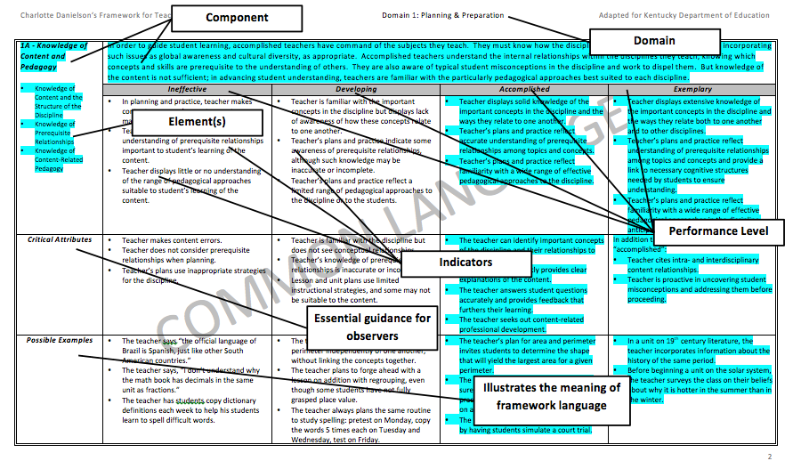
Notes:
Jennifer

Slide 36

Share and Discuss
Count off at your tables 1 – 5.
Move to like number groups and discuss the survey and self assessment.
1F = #1
2B=#2
3B=#3
3D=#4
4D=#5
Notes:
Jennifer

Slide 37
Assessment Literacy and
Kentucky Framework for Teaching
In your groups, read the component, elements, indicators, critical attributes, and possible examples for the Accomplished and Exemplary performance levels.
Identify the key words/phrases/ideas that connect with assessment literacy.
Choose someone from your group to briefly share the component and the connections to assessment literacy.
Notes:
Jennifer

Slide 38
1F: Designing Student Assessments
Congruence with Instructional Outcomes
Criteria and Standards
Design of Formative Assessments
Use for Planning
Notes:
Jennifer

Slide 39
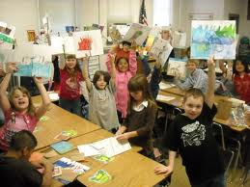
2B - Establishing a Culture for Learning
Importance of the Content
Expectations for Learning and Achievement
Student Pride in Work
Notes:
Jennifer

Slide 40

3B - Questioning and Discussion
Techniques
Quality of Questions
Discussion Techniques
Student Participation
Notes:
Jennifer

Slide 41

3D- Using Assessment in Instruction
Assessment Criteria
Monitoring Student Learning
Feedback to Students
Student Self-Assessment and Monitoring of Progress
Notes:
Jennifer

Slide 42
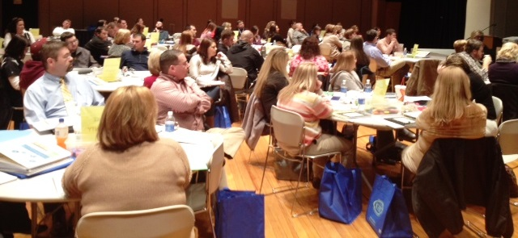
4D - Participating in a Professional
Community
Relationships with Colleagues
Involvement in a Culture of Professional Inquiry
Service to the School
Participation in School and District Projects
KVEC Social Studies Network Meeting
February 28, 2014
Notes:
Jennifer
Photo from February SS Network Meeting

Slide 43

Connections to Assessment Literacy
Look at the indicators on the Assessment Self Assessment
Identify which domain/component each indicator BEST represents
Share at your table
Notes:
Jennifer

Slide 44
Framework for Teaching
Domain 1: Planning and Preparation
Demonstrating Knowledge of Content and Pedagogy
Demonstrating Knowledge of Students
Setting Instructional Outcomes
Demonstrating Knowledge of Resources
Designing Coherent Instruction
Designing Student Assessments
Domain 2: The Classroom Environment
Creating an Environment of Respect and Rapport
Establishing a Culture for Learning
Managing Classroom Procedures
Managing Student Behavior
Organizing Physical Space
Domain 4: Professional Responsibilities
Reflecting on Teaching
Maintaining Accurate Records
Communicating with Families
Participating in a Professional Community
Growing and Developing Professionally
Showing Professionalism
Domain 3: Instruction
Communicating with Students
Using Questioning and Discussion
Techniques
Engaging Students in Learning
Using Assessment in Instruction
Demonstrating Flexibility and Responsiveness
Notes:
Jennifer

Slide 45

Reflection
As you think about the self assessment of assessment literacy you completed and today’s learning about the connections to TPGES:
What are some areas of professional learning you want to focus on to improve your own assessment literacy?
How will assessment literacy be evidenced in your teaching?
Notes:
Jennifer

Slide 46

12:00 – 12:45 P.M.
Move to Grade Level Tables (K-5, 6-8, 9-12)
after lunch
Notes:
Place grade level table tents on tables during lunch
Place post-its with Standard #s on tables

Slide 47


Standards for K-5 reading in history and social studies are integrated into the K-5 Informational Reading Standards.
The Reading in History/Social Studies Standards begin in 6th grade.
The CCR anchor standards and grade level standards work in tandem to define college and career readiness expectations – the former providing broad standards, the latter providing additional specificity.
Notes:
Carole: Anchor Standards are the same for ALL grades
Organization:
K-5 Reading CCR Anchor Standards: Page 10 of CCS
6-12 Content Literacy Standards: CCR Anchor Standard at the top of each Standard

Slide 48
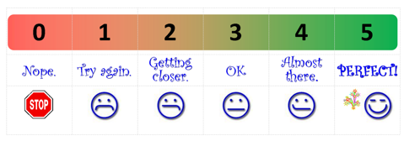
Literacy Standards: Rank Yourself
Beside each literacy standard for your grade level, on a scale of 1-5 rank your proficiency with that standard. Write it on your page of standards.
Identify any standard(s) you could easily improve upon.
Notes:
Carole (TLs should be sitting in grade level groups)
K-5 will use Informational Reading Standards
6-12 will use Literacy Standards for History/Social Studies

Slide 49
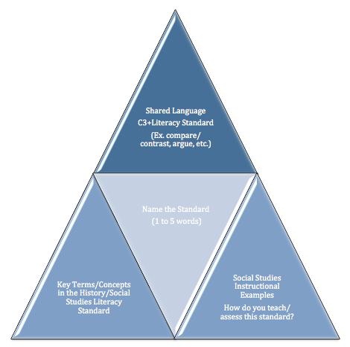
Literacy Standards:
Working Together to Make Meaning
Notes:
Carole (Handout)
Emphasize the value in the conversation with others about standards – their intent, nuances of language, progressions, what they look like during instruction and assessment.
You will be given a standard to read. Analyze your standard beginning with the middle triangle by “naming” the standard with a 1 – 5 word phrase.

Slide 50
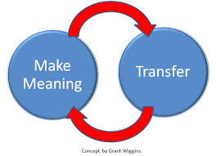
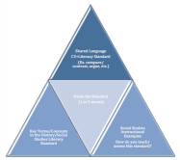
Notice the number on your table tent. This is the standard you will be addressing.
Work individually through the organizer.
Collaborate with table partners to come to a shared agreement about each element of the triangle.
Create a chart of your findings. (Be sure to include the Standard # and Names on Your Chart)
Place charts in Standard # order on the wall.
http://grantwiggins.wordpress.com/2012/01/11/transfer-as-the-point-of-education/
Notes:
Carole
Strategy we are using to “create meaning of the Content Literacy Standards” is based on Grant Wiggins (Understanding by Design) concept of “Make Meaning and Transfer” into your own instructional practices.
We are “modeling” an excellent strategy for you to use with your social studies students!
…since “understanding” surely implies, among other things “effective use of content.” Link to a post from Grant Wiggins that discusses “MM and Transfer” if you would like additional information.
Our GOAL is to determine: What do the literacy stds. “look like” in my classroom?
I will create a document to give you with each of the instructional strategies and teacher contact names listed.

Slide 51
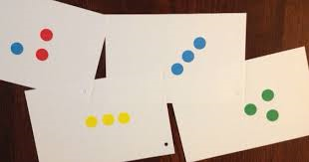
Gallery Walk
Place a colored sticker next to three instructional strategies you would like to know more about.
Record important ideas/strategies for each standard in your journal.
Notes:
Carole
I will create a document to share with you that includes each of the instructional strategies and teacher contact names listed on the chart.

Slide 52

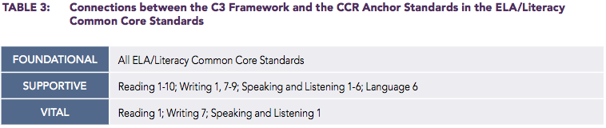
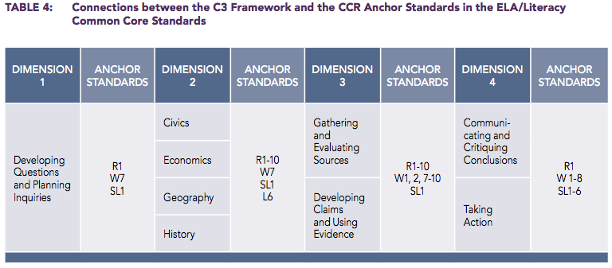
Connections
C3 Page 20
Notes:
Carole
Take a minute to note the connections. Notice what is VITAL – Standard 1.
This will move us into the breakout sessions after the break

Slide 53

1:45 – 2:00 p.m.
Move to Grade Level Group Session

Slide 54
Grade Level Group Sessions
Room 1
Grades K-5
Room 2
Grades 6-8
Main Room
Grades 9-12
Be sure to take all materials and belongings
to the grade level group session!
Notes:
Carole
Remind participants we will dismiss from grade level group session

Slide 55

“From Inquiry Arc to Instructional Practice”
  Refer to homework pages (C3 Section 3, pages xvii-xx).
  With an elbow partner discuss your “take aways” from what you read.
  Silently read the article “What’s the C3 Framework, and How does it Affect Your Social Studies Class?”
  As you read, make connections between the C3 pages and the article by highlighting, annotating, using post-its, etc.
Notes:
Grade Level Group Session: 15 minutes (Article in Folder)
Follow instructions on slide and have QUICK whole group share out on connections between C3 and article.

Slide 56

“Quiz Time” (C3 Pages xix-xx)
At your table, discuss the following:
Why do you feel that question # 1, 3, 5 and 6 were determined to “fit the bill” as compelling questions?
What was lacking in question # 2 and 4 that made them “weaker” choices as compelling questions, but strong as supporting questions?
Notes:
Grade Level Group Session: 5 minutes
Follow instructions on slide.
Transition into a silent reading using Close Reading… In order to answer compelling/supporting questions, students need to be taught strategies of how to “dig in” and retrieve the information…

Slide 57


Which of the following questions require students to read their text closely?
If you were present at the signing of the Declaration of Independence, what would you do?
What are the reasons listed in the preamble for supporting their argument to separate from Great Britain?
Notes:
Grade Level Group Session:

Slide 58

Close Reading Requires Students to:
Understand their purpose for reading
Understand the author’s purpose for writing
See ideas in a text as being interconnected
Look for and understand systems of meaning
Formulate questions and seek answers to those questions while reading
Notes:
Grade Level Group Session: (Review this slide quickly)
Why is CR important to finding evidence and answering questions in Social Studies?
The first reason is that the standards require that:
K-5 “…students must read widely and deeply from among a broad range of high-quality increasingly challenging literary and informational texts.” (Note on Range and Content, CCSS, page 10)
6-12 “…students must grapple with works of exceptional craft and thought whose range extends across genres, cultures, and centuries.” (Note on Range and Content, CCSS, page 35)
The second reason is that CR is an important aspect of instruction in Social Studies because it is an IMPORTANT college and career ready skill.
Today we are just introducing and “scratching the surface” of this instructional practice with you in order to make the connection that the QUESTIONS YOU ASK STUDENTS will determine how closely you students read!
We will study this practice in more depth next year.

Slide 59

C3 Framework: Dimension 1
Complete a “Close Read” of pages 23-24 with the focus of determining:
  Categories of questions
  Differences between compelling/supporting questions
  Qualities of compelling questions
Share your findings
Developing Questions and
Planning Inquires
Notes:
Grade Level Group Session:
Categories of questions: pg 23
Differences between compelling/supporting questions: pg 23
Qualities of compelling questions: pg 23
IF TIME: Have one person chart group “consensus” answers to the three bullets on slide.

Slide 60

C3 Framework Disciplinary Inquiry Matrix
Read/Review C3, Page 66
With your table group:
  Discuss the Matrix
  Clarify Differences Among the Content Sample Questions
Notes:
Grade Level Group Session: (Do Quickly)
(Point is to identify important information included in C3 book they can access later.)

Slide 61


Can you identify Compelling and Supporting Questions in a
Social Studies Lesson?
#1 #2
  Elementary:
  https://www.teachingchannel.org/videos/show-and-tell-themes
  http://www.youtube.com/watch?v=nF0BDeRyNi0
  Middle and High: https://www.youtube.com/watch?v=s8JpQsPQDW4
Video 1: SNL Seinfeld Video http://www.teachertube.com/viewVideo.
php?video_id=241598
Notes:
Grade Level Group Session: (Video Guide in Folder)
Use the video guide H/O and jot down any of Dimension 1 criteria you see and/or hear
Video 1: SNL Seinfeld Video (Weak) http://www.teachertube.com/viewVideo.php?video_id=241598
Video 2: Soc Stu Teacher Video (Good)
Elementary:
Middle and High: https://www.youtube.com/watch?v=s8JpQsPQDW4

Slide 62
#2
Teacher referred to having students look at history with a critical lens “What were conditions the immigrants faced? Where did you find that?”)
Teacher kept students focused on text based questions
Teacher works with library media specialist to be sure they have sources students can access for research
Teacher asks “What are the 3 top issues you think should go in this chart?”
Teacher engages in questioning: “What is it uncovering?” “What is unsafe?” “What major issue are they uncovering?”
Teacher refers students to text to find answers

Slide 63
Reflect on the “big ideas” from
today’s meeting.
Social Studies
Teacher Leader Network
KY
Tpges
C3
Dimension 1
C3
Inquiry
arc
Literacy Standards
In History/Soc. Stu.
Assessment
literacy
Notes:
Grade Level Group Session:
Journal any thoughts, ideas, plans, items to remember…

Slide 64

  Develop a Compelling Question and a Supporting
  Question for a unit/lesson you will teach before the
  next network meeting.
  Write your questions on the provided organizer
  and bring with you to the April 24th network
  meeting.
  Be prepared to share your questions and any feedback
  pertaining to your students.
Notes:
Grade Level Group Session: (Handout: Distribute Homework Organizer)

Slide 65
IMPACT LOGS
Logs should be submitted to Carole Mullins in hard copy or via e-mail at the end of each month.
Notes:
Grade Level Group Session: (Hard Copy in Folder, Electronic Version on Website)
Very important that your work is documented and submitted to KDE…
Complete a log for any work you have done in your district. This includes, but is not limited to, meetings attended/participated, trainings and informational sessions conducted, etc. In other words, anything you do that is related to the work of the network initiative. (If you don’t have documentation of specific dates, just include the month)
The documentation log asks very specific questions and some of them will NOT pertain to every activity you have done and/or will do in the future. The point is that you work is documented!

Slide 66

Remember…
Turn in your Evaluation
Get your certificate
Our next meeting is:
24th
Notes:
Grade Level Group Session:
Distribute Certificates

