Slide 1

Social Studies Teacher Leader Network
February 28, 2014
Welcome!
Notes:
Carole:

Slide 2


Design a Name Plate that will be used at every Social Studies Network Meeting
Be sure to include the following information:
  Your Name (Make first name large)
  Name of District and School
  Grade Level and Subject/Course Taught
Be Creative!!

Slide 3

Your Facilitators for Today
Carole Mullins
KDE/KVEC Instructional Specialist
Mary McCloud
KVEC Literacy Consultant
Linda Holbrook
KDE Literacy Consultant
Jennifer Carroll
KDE/KVEC Professional Growth and Effectiveness
System Consultant
Notes:
Carole

Slide 4


Felicia C. Smith
Kentucky Department of Education
Associate Commissioner
http://media.education.ky.gov/video1/On-Demand2014/F_Smith_1-7-2014.mp4
Notes:
Evaluation
Binder Cover and Spine
Restrooms
Resources
Upcoming website
Journals

Slide 5

Leadership Networks Vision:
Every school district in the Commonwealth of Kentucky has a knowledgeable and cohesive leadership team that guides the professional learning and practice of all administrators, teachers, and staff so that every student experiences highly effective teaching, learning and assessment practices in every classroom,
every day.

Slide 6


TARGETS FOR TODAY:
I can recognize my roles/responsibilities/expectations as a Social Studies Teacher Leader for my district.
I can identify the goal of the Leadership Networks as a capacity building approach.
I can identify the four pillars of the network and other foundational supports that provide students access to College and Career Readiness.
I can analyze the structure and intent of the College, Career, and Civic Life (C3) Framework for Social Studies.

Slide 7

THINKING PARTNERS
ACTIVITY
Notes:
Handout – Follow Instructions

Slide 8

What commitments/norms should social studies network participants share?
I commit to:
Notes:
Because Civic Dispositions are specifically mentioned in the SS CHETL we are going to use them for developing our network’s group norms.
Civic Dispositions will allow TLs to establish norms for communicating throughout this network.
Modeling how to create an environment that promotes critical thinking and rigorous classroom conversations/discussions.
Provide Instructions Norms Activity (Civic Dispositions Handout and Norm Handout-1 per table)
Choose one CD per table and develop a network meeting norm;
Write Table’s Norm on provided sheet.
Facilitator’s will pick up norms and “reveal” later in meeting

Slide 9
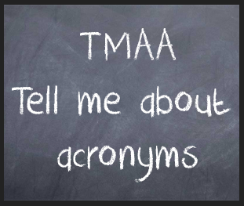
Acronym Challenge
KCAS | CLS | ICM | KVEC | EOC
CHETL | CCSS | PPGES | CCR | PGP
FfT | CASL | PLC | KDE | TPGES
PGES | LDC | C3F | NCSS | SGG
Notes:
TLs sort these acronyms into categories based on their understanding of the meaning of the acronyms. (Secret: There is no real categories!)

Slide 10
KCAS: KY Core Academic Standards
CLS: Content Literacy Standards
ICM: Innovative Configuration Maps
KVEC: Kentucky Valley Educational Cooperative
EOC: End-of-Course
CHETL: Characteristics of Highly Effective Teaching and Learning
CCSS: Common Core State Standards
PPGES: Principal Professional Growth and Effectiveness System
CCR: College and Career Readiness
PGP: Professional Growth Goal
FfT: Framework for Teaching
CASL: Classroom Assessment for Student Learning
PLC: Professional Learning Community
KDE: KY Department of Education
TPGES: Teacher Professional Growth and Effectiveness System
PGES: Professional Growth and Effectiveness System
LDC: Literacy Design Collaborative
C3F: College, Career, and Civic Life Framework for Social Studies State Standards
NCSS: National Council for Social Studies
SGG: Student Growth Goals

Slide 11


Take Notes
Reflect
Social Studies
Teacher Leader Network
Plan
Notes:
Refer participants to the provide Journal. Explain how we will use them at all network meetings

Slide 12

Kentucky Leadership Networks…
What Participants Need to Know
Task:
Take five minutes to review “Kentucky Leadership Networks—What Participants Need to Know”
Journal Reflection:
Why am I here (what is my role)?
How do my individual strengths support this vision?
What is my goal for participation in the Leadership Network for Social Studies?
Notes:
Kentucky Leadership Networks What Participants Need to Know (binder)
Characteristics of the Right Network Participant
Released Statement from Karen Kidwell Social Studies Networks
After reflecting individually, share with the members of your district team your goals for this work.

Slide 13

Pillars again
Highly Effective Teaching and learning
Professional Learning
Kentucky’s Core Academic Standards - KCAS including CCA4.1, CCSS & NGSS
Network Foundations…
Assessment Literacy
Leadership
TPGES –Teacher Professional Growth and Effectiveness System
Notes:
Pillars of the SS TLN Meetings:
CHETL
Assessment Literacy
Leadership
KCAS
STAND AND DELIVER: Review of Network Goals/Pillars of Work—
“Today we will place more emphasis on the Standards Pillar & the Leadership Pillar, but will definitely pick the others up at another meeting.
It’s important to understand these pillars are not independent of one another (Coherence, three-legged stool), though our activities may highlight one particular pillar more than another…
We recognize that most teachers have received a great deal of Professional Learning lately around formative assessment, but have not, generally, had the opportunity to work with C3/CCSS.”
These pillars all come together in the TPGES

Slide 14


1. Kentucky’s Core Academic Standards
  How are you understanding & implementing
the standards in your classroom, school & district?
2. Highly Effective Teaching and Learning
  How are you emphasizing highly effective teaching and learning characteristics in your classroom, school & district?
3. Assessment Literacy
  How are you using formative/summative assessment to improve instruction & learning in your classroom, school & district?
4. Leadership
  How are you using the leadership capacity you are building to share information in your school & district?
Notes:
KCAS: Update on SS Stds. Handout; SS CC 4.1 and Literacy Standards Handout
CHETL: SS CHETL Document
ASSESSMENT LITERACY: Balanced Assessment Survey and CASL: Take survey, then place in binder for use at the next meeting.
LEADERSHIP: Activity on Next Slides

Slide 15

You were chosen to be a network participant, WHY?
What characteristics do you possess that make you the “right” person for the job of Social Studies Teacher Leader?
Journal Activity:
  Make a list of the skills, experience, training, etc. you have that make you the “right” person for the leadership network.

Slide 16

Characteristics of the “Right” Network Participants
Compare your list of characteristics with the handout. Highlight any that are similar.
Using another color of highlighter, identify any characteristic(s) that you wish to grow/improve through participation in the network.
Choose ONE bullet from your identified “grow list”. Write it on a post-it note and attach to the Wall Chart.
Notes:
Debrief: What are strengths we have as a group? How can we assist one another? What are some things we may need to focus on?

Slide 17

District Team Debriefing
Share your strengths with your district team.
How will your teacher leader strengths, instructional strengths and content area strengths help your district team?
How will you utilize the strengths of your teammates?

Slide 18

Through a capacity building approach,
the goal of the Leadership Networks is to focus on professional learning around KCAS, CHETL, Assessment Literacy, and Leadership in order to support College and Career Readiness for all students.
Notes:
The Leadership Network concept/design is based on the most current research-based data that we have on effective professional development (that is, professional development that actually leads to improved classroom practice). The focus of the networks is capacity building, not a ‘train the trainer’ model.
Since this is CB is one of our ultimate network goals, let’s clarify it…

Slide 19

Capacity Building vs Train-the-Trainer
Capacity Building:
means people will attend meetings and be presented the most current information and the opportunity to try out the most effective strategies, resources, and tools available. They will take this information, and with their district leadership team, develop a customized plan for professional learning for teachers in their districts.
“Train the Trainer”:
means people will attend training and be given information and materials so that they may conduct the same training in their school or district for their professional learning program. In essence a “clone” is created who can replicate a program, but may be unable to adapt should any change to that program be necessary.
Notes:
Capacity Building Model vs Train-the-Trainer Model
Give instructions for Journal Activity:
Capacity Building vs. Train the Trainer:
Read short definitions on Slide
Provide instructions for Journal Activity: Make a T-Chart for CB and TtT Model in journal. List characteristics of each Model.
Distribute CB vs TtT (Handout) with completed T-Chart
Compare your responses
Table and Group Discussion

Slide 20

10:30 – 10:40 a.m.

Slide 21
Teaching is complex…
“Teaching is a profession more complex than medicine.”
  Lee Shulman, “The Wisdom of Practice”
Notes:
Carole:
The focus on professional growth is not because our teaching is bad, but rather because teaching is complex

Slide 22

What Is “a Framework for Teaching” ?
A description of the teacher responsibilities that promote improved student learning.
A definition of what teachers should know and be able to do in the exercise of their profession, based on research and best practice.
A common language that allows opportunities for educators to discuss good teaching.
A structure designed to address the complexities of teaching applicable to all practitioner levels from novice through accomplished.
Notes:
Carole
Walkthrough information on Slide
How many of you are participants in the pilot or have seen the Framework?
I’m going to give you a quick introduction to the it, but our focus will be making the connection to NGSS

Slide 23

KENTUCKY’S FRAMEWORK FOR TEACHING
Notes:
Carole
Request participants to pull out this document for use

Slide 24
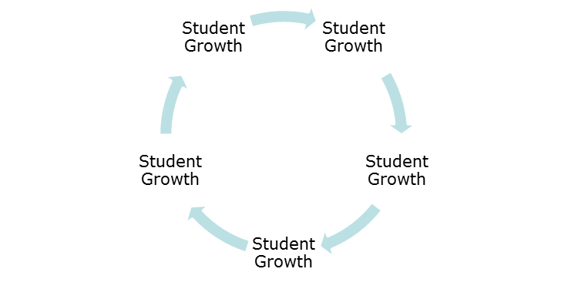

Framework for Teaching
Domain 1: Planning and Preparation
Demonstrating Knowledge of Content and Pedagogy
Demonstrating Knowledge of Students
Setting Instructional Outcomes
Demonstrating Knowledge of Resources
Designing Coherent Instruction
Designing Student Assessments
Domain 2: The Classroom Environment
Creating an Environment of Respect and Rapport
Establishing a Culture for Learning
Managing Classroom Procedures
Managing Student Behavior
Organizing Physical Space
Domain 4: Professional Responsibilities
Reflecting on Teaching
Maintaining Accurate Records
Communicating with Families
Participating in a Professional
Community
Growing and Developing Professionally
Showing Professionalism
Domain 3: Instruction
Communicating with Students
Using Questioning and Discussion
Techniques
Engaging Students in Learning
Using Assessment in Instruction
Demonstrating Flexibility and Responsiveness
Notes:
Carole
Refer participants to page 3 of the framework: (I use this page first because it is easier to understand than page 2!)
This is an overall view of the Domains, Components (Letters) and Elements (roman numerals) on page 3.
Each one further clarifies the other
Additional information and clarifications are on the component pages of the framework

Slide 25
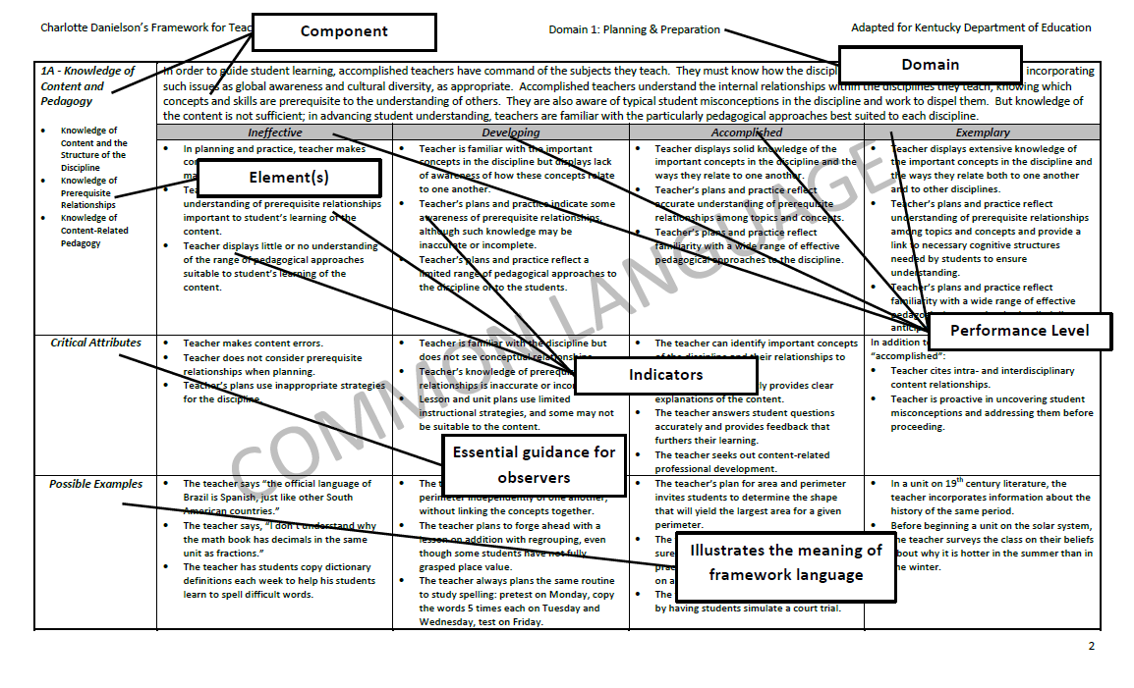
Notes:
Carole
Refer participants to Page 2 of Framework … it is important to understand some common language.
Page two (2) of the Kentucky Framework for Teaching has this sample page highlighting the design of the document. It is important to understand this design because it is consistent across each of the five (5) domains.
Walkthrough Page 2 of Framework
Allow a few minutes for TLs to “study”

Slide 26

PowerPoint adapted from the following sources:
*LA County Office of Education C3 Webcast
*Dr. Kathy Swan's "Achieving the C3: An exploration into 21st century social studies"
Notes:
Linda

Slide 27
Digging into the C3 Document
C3 Scavenger Hunt
Learning Target: Analyze the structure and intent of the C3 Framework for Social Studies to transform teaching and learning.
What is the C3 Framework?

Slide 28

Picture Prediction: Based on the symbols included in this graphic, predict what you think might be the critical components of the C3 framework.
Notes:
Scavenger Hunt Page 1: Top Section

Slide 29

Video Webcast
Video Panelists include:
Host Michelle Herczog, Consultant III, History-Social Science, Los Angeles County Office of Education and the architects of the document
Susan Griffin, Executive Director, National Council for the Social Studies
Kathy Swan, Ph.D., Project Director and Lead Writer of the C3 Framework, Associate Professor of Social Studies Education, University of Kentucky
http://www.lacoe.edu/Home/Videos/PlayVideo/TabId/202/VideoId/220/College-Career--Civic-Life-C3-Framework-For-Social-Studies-State-Standards.aspx
Notes:
WEBCAST: Introducing the College, Career, and Civic Life (C3) Framework for Social Studies State Standards: Will not watch entire video… only about 18 mins.
This archived webcast describes the history and background of the document, the distinguishing characteristics of the Inquiry Arc and Four Dimensions that guide the work, connections to the Common Core State Standards for English Language Arts, and information about the implementation phase.

Slide 30


What is the intent of the C3 Framework?
Let’s begin our quest by completing Page 1
Notes:
Complete Scavenger Hunt Page 1 and Discuss

Slide 31
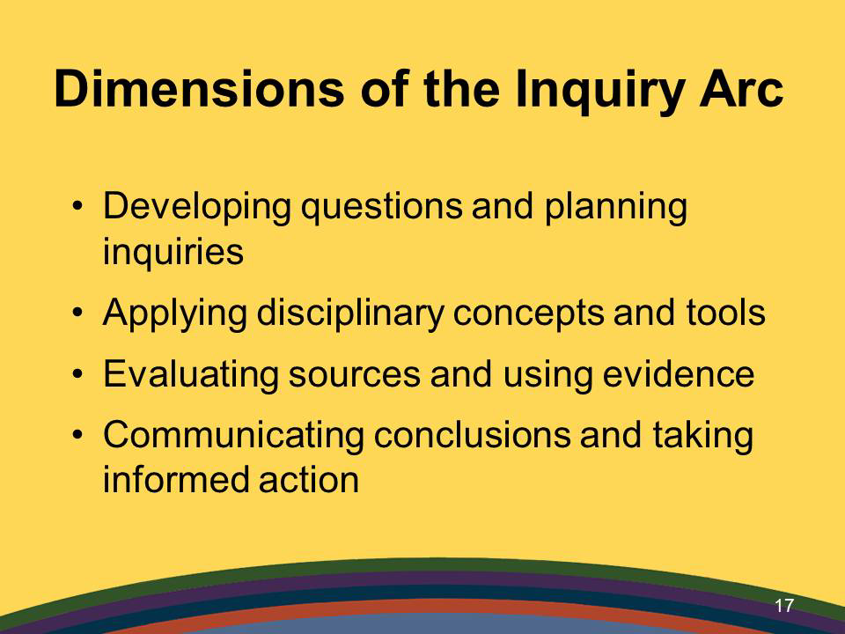


Notes:
ROOTS OF THE 4 DIMENSIONS RUN DEEP!
We will look closely at them after lunch

Slide 32



Grade Level Groups
(Sessions begin at 1:00 p.m.)
LUNCH TIME!
K-5: Room 223
6-8: Room 224
9-12: Main Room
12:15-1:00 p.m.

Slide 33
C3 Inquiry Arc
Notes:
What is at the ROOT of the design of the C3 Framework Inquiry Arc? What do these symbols represent?
Distribute (white) Handout of C3 framework. ANSWERS ON NEXT 4 SLIDES
At your tables, try to identify the symbols that represent the “roots” of the C3 IA.
Allow a short time to do this on their own, then give answers/explanations: DON’T SPEND A LOT OF TIME ON THIS…

Slide 34

DIMENSION ONE: Developing Questions and Planning Inquires
Constructing Compelling Questions
Constructing Supporting Questions
Determining Helpful Resources
Notes:
Putting all the pieces together to begin a study of the content…

Slide 35

DIMENSION TWO: Applying Disciplinary
Concepts and Tools
CIVICS
ECONOMICS
GEOGRAPHY
HISTORY
Notes:
Content…

Slide 36

DIMENSION THREE: Evaluating Sources and
Using Evidence
Gathering and Evaluating Sources
Developing Claims Using Evidence
Notes:
Evaluating primary and secondary resources…

Slide 37

DIMENSION FOUR: Communicating Conclusions and
Taking Informed Action
Communicating Conclusions
Critiquing Conclusions
Taking Informed Action
Notes:
Communicating results…

Slide 38

Civics
Subsection
Subsection
Civic and Political
Institutions
Participation and
Deliberation
By end of grade 2…
Roles/responsibilities of people authority
Roles in a community
Purposes of rules in/out of school
Functions of governments
How communities work
Processes, Rules, and Laws
Subsection
Under each subsection, list the main ideas from the pathway indicators for your grade level.
Notes:
Refer participants to pages 32-34 and walkthrough the book and slide to explain how each section is “designed”, etc.
Point out the TABS on the table and provide guidance as to how they can TAB if they want to do so as we go through analyzing the C3 book.
I’ve allowed 15 tabs per person. They can also take tabs home and do the tabbing later, if they want…

Slide 39
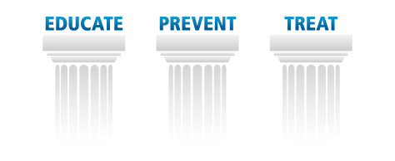
Inquiry
Arc
Disciplinary
Literacy
Civic
Life
C3 Foundations
Notes:
C3 Foundations Summarized: Pages xiii-xiv (13-14)
Don’t spend a lot of time on this slide. It is just a condensed, summary of the entire C3. It is referred to in the video.

Slide 40
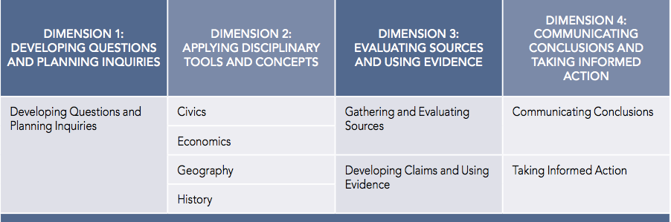
C3 Inquiry Arc
Notes:
Suggestion:
Read/Review top of page 12
Review Table 1
Make connections to cover icons from earlier activity…

Slide 41
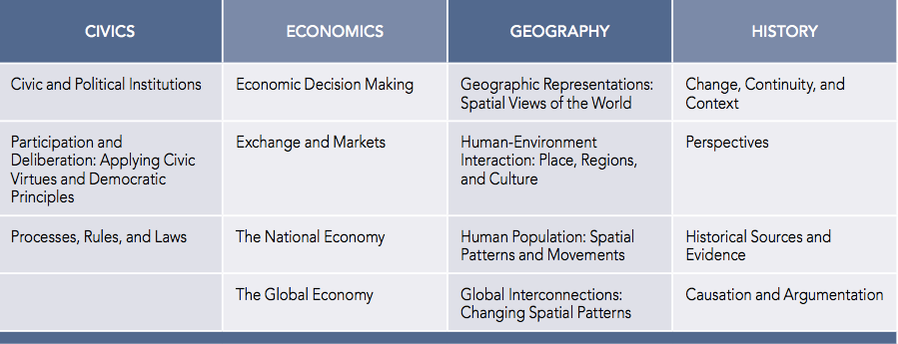



Dimension 2:
Applying Disciplinary Tools and Concepts
Notes:
Suggestion:
Refer to 1st paragraph on page 13
Review Table 2
Make connections to cover icons from earlier activity

Slide 42
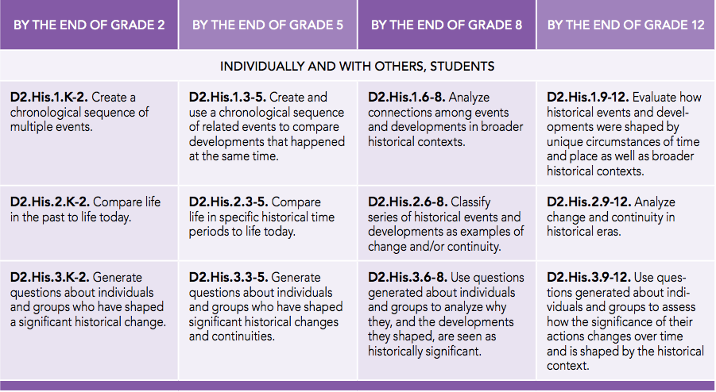
History K-12 Pathway
Notes:
Suggestion:
Refer participants to page 46
Table 20

Slide 43

Examine the Four Dimensions of the C3 more closely by completing the Scavenger Hunt.
Notes:
SUGGESTED INSTRUCTIONS FOR COMPLETING THE SCAVENGER HUNT:
Review the remaining pages of Scavenger Hunt.
Instruct participants to complete it using their own learning style. They SHOULD fill in the “boxes”/subsections, but then they can decide on their own how else they want to complete the information (writing it on SH or highlighting in their book)

Slide 44

Reflections on C3
Your Task: With your table group, discuss the following questions:
1. What are some things you observed about the structure and/or content of the C3 document?
2. What is new or different about the content or skills in C3?
3. What sounds similar to Common Core? ACT Quality Core? Core
Content?
4. Questions or concerns?
Notes:
Stop and DO THIS AT 1:50 even if participants not completely finished with Scavenger Hunt.
Encourage them to continue to read/review/analyze the C3 book on their own.

Slide 45



Slide 46


Please Note…
FRAMEWORK ≠ STANDARDS
October 2014: First Reading of KCAS in Social Studies to the KY BOE
December 2014: Second Reading of KCAS in Social Studies to the KY BOE
Full Implementation: 2015-16 School Year
Notes:
REMIND PARTICIPANTS:
The Final C3 Framework was released on Constitution Day, September 17th. It is designed to guide states in the development of their standards. The major characteristic of the C3 is emphasis and support for the change in instruction! It is a Paradigm shift.
Teacher, School, and District Leaders participating in Kentucky’s Leadership Networks for Social Studies will have multiple opportunities to dig into the framework, analyze its strengths and provide feedback on the usefulness of it to inform Social Studies standards and practice.
Kentucky’s goal is to have a solid, defensible, world-class draft of college/career ready standards to present to the Kentucky Board of Education SOMETIME in 2014.
October 1st Read
December 2nd Read
Implementation: 2015-16 School Year

Slide 47

2:00 – 2:10 p.m.
Return to Main Room!

Slide 48

“Agents of Change”
The only way to make sense out of change is to plunge into it, move with it, and join the dance. --Alan Watts
Notes:
YOU ARE AN AGENT OF CHANGE!!
You have “plunged in” and will “move with it” and “join the dance” as we continue our future work in the SS network meetings.

Slide 49

What is Historical Thinking?
Five Key Aspects
Analysis of Primary Sources
Multiple Accounts & Perspectives
Sourcing
Claim-Evidence Connection
Context
www.teachinghistory.org
Notes:
Carole:
Use this video to introduce what historical thinking is and why it is important.
Historical thinking is complex and multi-faceted; we focus on five key aspects particularly relevant to the K-12 classroom. These are:
Multiple Accounts & Perspectives
Analysis of Primary Sources
Sourcing
Context
Claim-evidence Connection

Slide 50


Think Like A Social Scientist
Teacher leaders will corroborate sources and utilize historical thinking skills while engaging in an inquiry based approach to learning.

Slide 51


What is the story of Rosa Parks? Generate thoughts, words, themes, facts, etc. associated with Rosa and the infamous bus ride.

Slide 52
Some Common Information
Seamstress– tired from the day and just sat down
Bus was full, and seat up front was only seat available
Did not intend to start a movement
Incident resulted in boycott of public transportation across South
Bus driver asked her to move
She sat at front of the bus
What if she didn’t sit where folklore tells us? What if she really didn’t break the law? Would we regard this incident differently?
How do you know?
Notes:
Compelling Questions

Slide 53
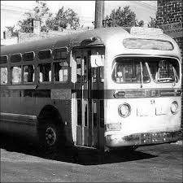
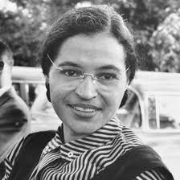
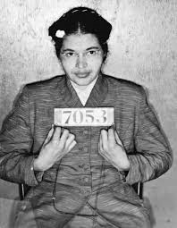
Where did
Rosa Parks Sit?

Slide 54

Background Information
36 seats on bus + driver’s seat
10 seats behind the driver considered front & “sacred 10”
16 seats in the “middle”
10 seats considered the “back”

Slide 55


Look at the Resources
Tool 7.1– Mark where you think Rosa sat.
Sources 7.1 & 7.2– Work with a partner to analyze the 2 primary source documents and complete the chart on Tool 7.1.

Slide 56

Where did
Rosa Parks Sit?

Slide 57

…The bus driver had a history with Rosa from another incident 10 years prior concerning where to sit on the bus? Was he aggravated with Rosa?
…The policemen working the case needed to justify the arrest? Why the conflicting infractions?
…Rosa Parks was the secretary for NAACP?
…Rosa Parks completed a summer course on civil disobedience?
…Seat assignment or designations differed based on driver preference?

Slide 58
Rosa Did Not Break
The Law?

Slide 59
Rosa Did Not Break the Law?
“It shall be unlawful for any passenger to refuse to take a seat among those assigned to the race to which he belongs, at the request of any such employee in charge, if there is such a seat vacant.”– Montgomery City Code
“The conductor or agent of the motor transportation company in charge of any vehicle is authorized and required to assign each passenger to the division of the vehicle designated for the race to which the passenger belongs.—Code of Alabama” (Jim Crow Laws)
Notes:
Make Connections

Slide 60

Connections
C3 Framework: Inquiry Arc
  Dimensions 1, 2, 3
Social Studies Standards: CCA 4.1
  EL: SS-05-5.2.4
  MS: SS-07-5.1.2 and SS-08-5.1.2
  HS: SS-H-5.1.2 and Quality Core
TPGES (FfT): Domain 3C-Student Engagement
CHETL: Instructional Rigor & Student Engagement
English LA/Literacy Standards in History and Social Studies:
  Anchor Reading Standard 1
  Anchor Writing Standard 7
  Anchor Speaking and Listening Standard 1
Notes:
Message: The C3 Framework and CC Lit Standards ask students to learn, participate, consider in a way similar to what teachers experience in this lesson demonstration.
Because of time, I’m going to go ahead and share the connections to standards, etc. Stacy will use these connections later as we discuss Student Growth Goals
Anchor Reading Standard 1:
Read closely to determine what the text says explicitly and to make logical inferences from it; cite specific textual
evidence when writing or speaking to support conclusions drawn from the text.
Anchor Writing Standard 7:
Conduct short as well as more sustained research projects based on focused questions, demonstrating
understanding of the subject under investigation
Anchor Speaking and Listening Standard 1:
Prepare for and participate effectively in a range of conversations and collaborations with diverse partners, building on others’ ideas and expressing their own clearly and persuasively.

Slide 61

“Reading Like A Historian”
Teaching Literacy in Middle & High School Classrooms
By Wineburg, Martin and Monte-Sano
…increasing academic literacy and sparking students’ curiosity… Primary documents, charts, graphic organizers, visual, and political cartoons follow each essay…
Notes:
Carole
Point out that in cases where the original language of a source poses a barrier to most students, the authors have adapted primary documents, conventionalizing spelling, simplifying syntax and occasionally introducing changes in vocabulary – all while trying to retain as much of the original texture and feel of the document as possible.
Turn to page 115 and see where Rosa actually sat!

Slide 62


NEXT STEPS: Leadership Networks
Assessments
Current
State
Standards
(KCAS SS and Literacy in History/SS)
Curriculum
+
Instruction
Teacher Development
Notes:
Our network will spend time looking at what is CURRENTLY AVAILABLE to inform highly effective practice.
As we do so and get more information from the field, then we can decide how best to revise standards. Through your participation in the network, you will have the opportunity to provide feedback, etc.
Kentucky’s goal is to have a solid, defensible, world-class draft of college/career ready standards to present to the Kentucky Board of Education SOMETIME in 2014.

Slide 63


SILENT CONVERSATION:
Write Your Name in the top right hand corner of the handout.
Complete Box 1 by generating a question concerning any of the day’s information.
Pass it to the person on your right.
Continue this process and complete a box as it comes to you.
Make sure each person’s form is completed and given back to them.
Review your responses. Share any big ideas at your table.
Turn the completed form into a facilitator.
Notes:
Carole (3:10-3:25)

Slide 64
IMPACT LOGS
Logs should be submitted to Carole Mullins in hard copy or via e-mail at the end of each month.
KVEC
Social Studies TLN Meetings
February 28, 2014
March 28, 2014
April 24, 2014
Summer: TBD
Notes:
Carole
Very important that your work is documented and submitted to KDE…
Complete a log for any work you have done in your district. This includes, but is not limited to, meetings attended/participated, trainings and informational sessions conducted, etc. In other words, anything you do that is related to the work of the network initiative. (If you don’t have documentation of specific dates, just include the month)
The documentation log asks very specific questions and some of them will NOT pertain to every activity you have done and/or will do in the future. The point is that you work is documented!
Logs should be submitted to me by the end of each month. Electronic version is available on Bb.

Slide 65

for March 28, 2014
Read “From Inquiry Arc to Instructional Practice” pages xvii-xx in the C3 Framework.
Read the introduction to Reading Like a Historian (pages ix-xii).
  Respond to the Reading Guide Prompts in your journal.
  Be prepared to share your responses at the March 28th meeting.
Notes:
Carole
C3 assignment: 4 pages
RLHA assignment: 4 pages

Slide 66

Inclement Weather Procedure
If Perry County Schools are closed for inclement weather, the KVEC Social Studies Network will not meet.
Please check WYMT or the Lexington TV stations and/or websites for school closing information.
No make-up session(s) will be scheduled in January or February. We will maintain the regular meeting schedule and establish make-up date(s) as needed in the spring.
Notes:
Carole

Slide 67


Remember…
Turn in your Evaluation
Our next meeting is:
28th
Notes:
Carole

