Slide 1
Questions: The heart of the C3 Framework
KVEC Social Studies Teacher Leader Network
K-4 Session
December 2, 2014
Inquiry ARC Dimension 1 and 3
Standards: Reading Writing, Speaking and Listening
Evaluating Primary and Secondary Sources
Notes:
Participants need to sit in grade level bands.
K-1, 2-3, 4

Slide 2

Session Targets
I can make connections using ELA Standards, 3C Framework, TGES and Social Studies draft standards.
I can distinguish between primary and secondary sources.
I can participate in a structured turn and talk discussion.

Slide 3


Do we really need to do this?
Becoming college and career ready begins
the moment a child enters school until they
graduate.
Notes:
Make sure participants have a packet of materials they will need:
Anchor Thinking Chart for Connections section
Copy of the ELA standards slide
PGES domain 3
13 pages of the draft social studies

Slide 4
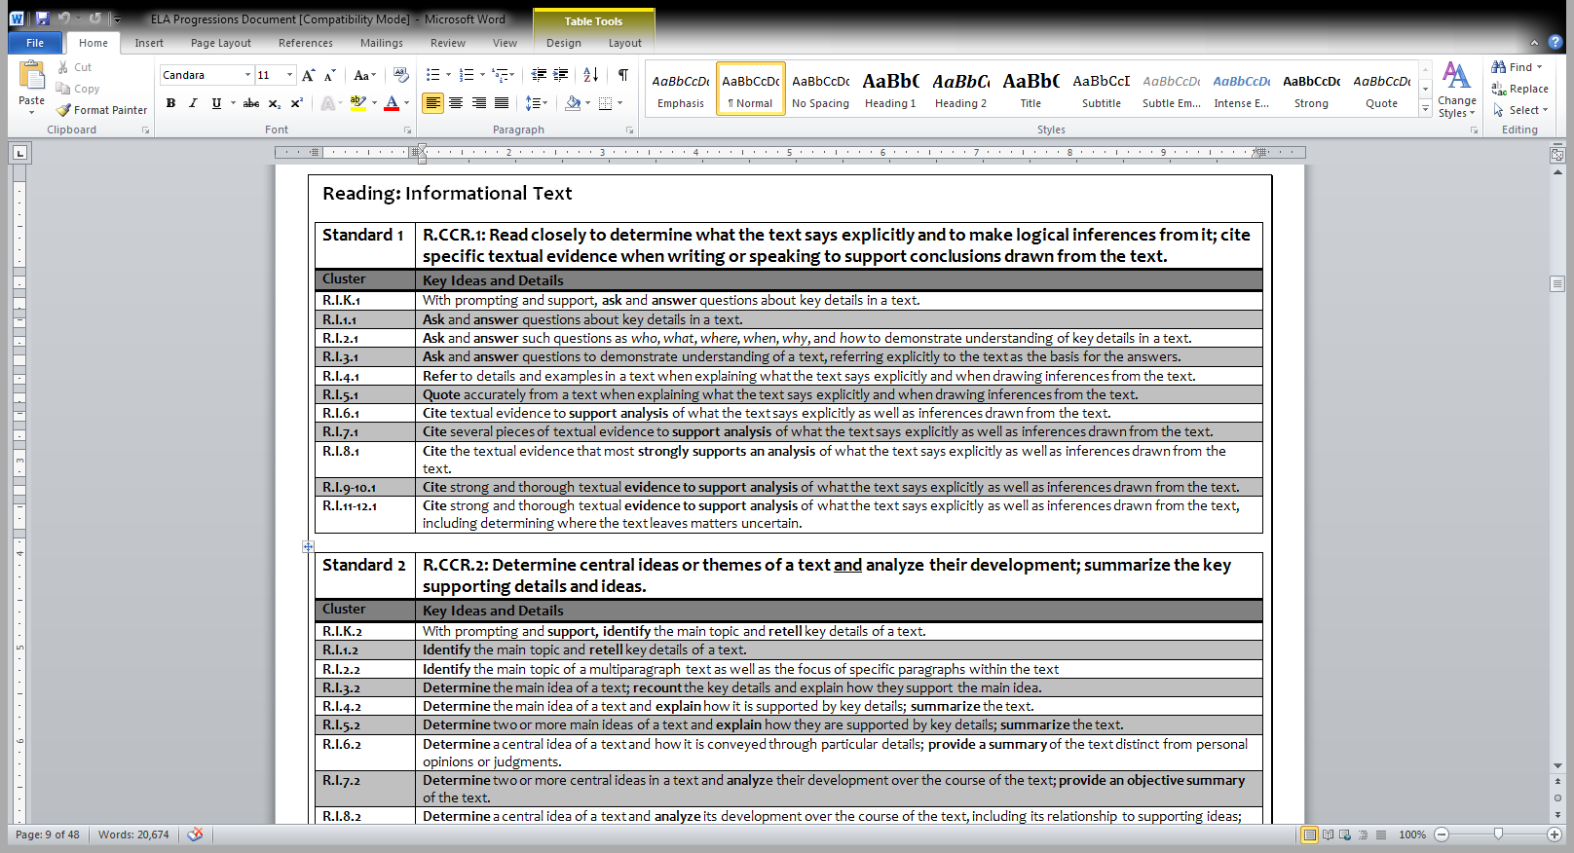
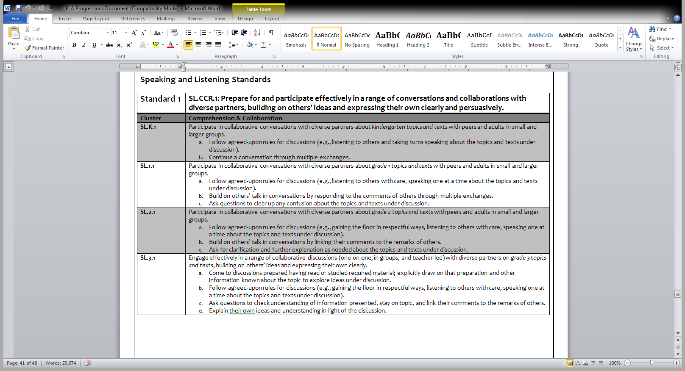
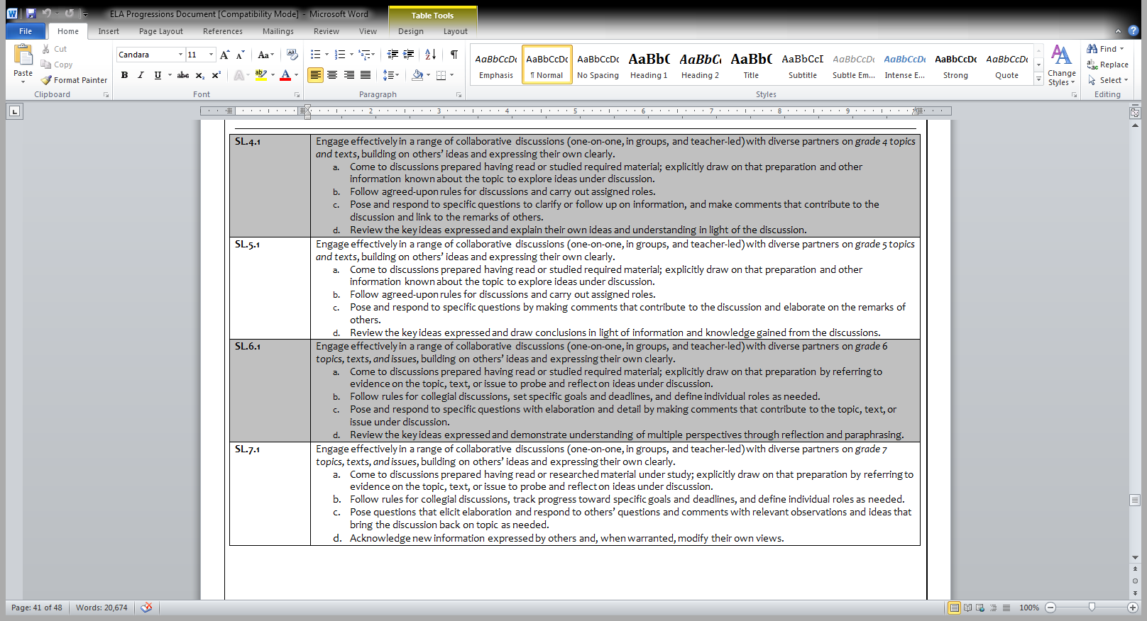
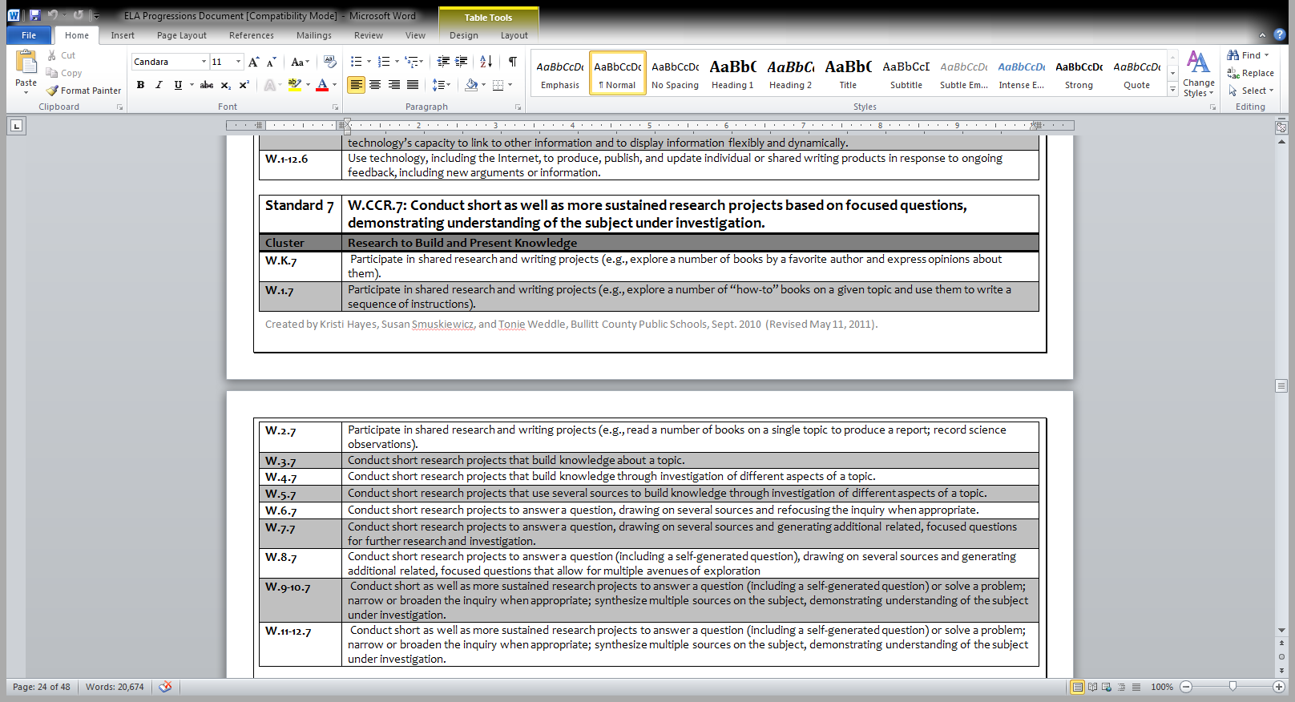
ELA STANDARDS
Notes:
Lets begin with looking at the first set of standards that were adopted in 2010.
Participants can use the Batelle ELA standards booklets to explore the progression and discuss. (Address informational text and where to begin open Appendix B from Common Core Standards for grade level texts). Begin by looking at informational reading standards, then writing standards, making sure to tie in opinion writing and social studies connection. End with the speaking and listening standards. How do this effect me and what I teach?

Slide 5
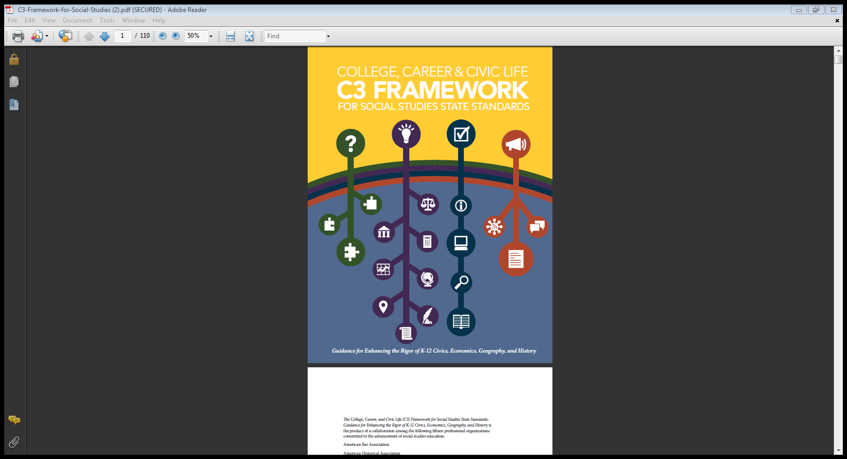
Questioning is key to student learning
Dimension 1 features the development of questions and the planning of inquiries.
Notes:
Have participants turn to page xxi. Read orally have them highlight connections between ELA standards and social studies discipline.
Using the Anchor Thinking Graphic Organizer participants will provide explicit quotes from the text on Dimension 1.

Slide 6
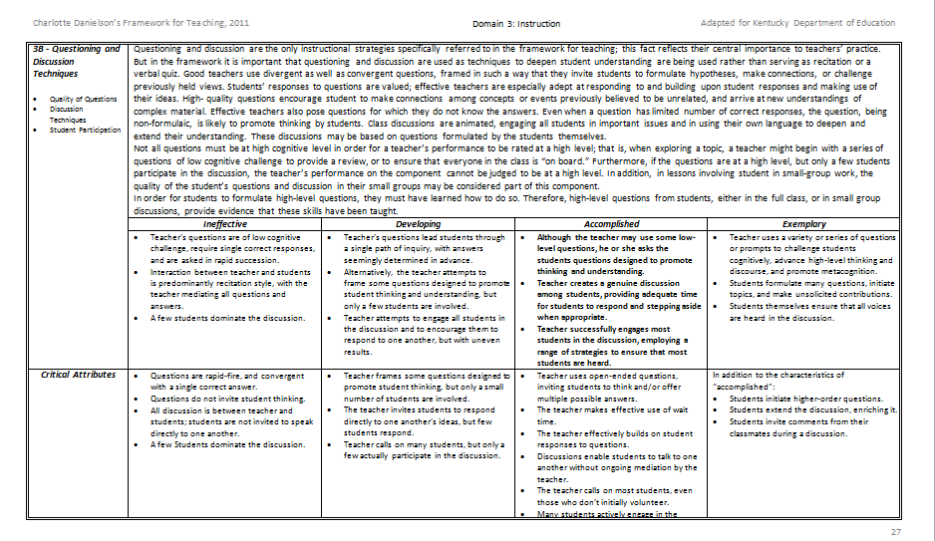
Domain 3: Instruction
3b – Questioning & Discussion Techniques
Notes:
Handout remind participants of the activity from October’s meeting. Refer back to anchoring chart. They should support the comments that are common between C3 Framework, ELA standards and record responses.
Instructions for Activity on next slide

Slide 7
SS Draft Standards
Social Studies Standards for the Next Generation
Draft July 2014
Kentucky Core Academic Standards
Notes:
Participants should take the 13 page handout of the Social Studies Draft Standards, look closely at the 15 Anchor Standards, each grade group will read the preface before the standard and then the standards for their grade level. Such as Kindergarten will read the preface on page 4 and the standards on page 5 make comments on the Anchor Thinking Chart. Allow 5 minutes.

Slide 8
Connecting the dots……
What is the central idea(s) of
each of these documents?
ELA STANDARDS
C3 Framework
TGES
Social Studies Draft Standards
Notes:
With your table group identify the central idea of each of these documents. Table Groups will share out with each other noting the most important or central theme from their anchoring charts. The person who teaches closest to the college will chart the findings of the group. The person teaching the least years will present the findings to the group for each grade band.

Slide 9
The Big Idea
Students are more successful when they learn to ask their own questions.

Slide 10

Reflection Time
In your journal write down the main points that you want to make with your teachers.

Slide 11
Dimension 1
Constructing Compelling Questions |  | Constructing Supporting Questions |  | Determining Helpful Sources
By the end of Grade 2 | By the end of Grade 5 | By the end of Grade 2 | By the end of Grade5 | By the end of Grade 2 | By the end of Grade 5
Explain why compelling questions is important to the student. | Explain why compelling questions are important to others | Identify facts and concepts associated with supporting questions. | Identify the disciplinary concepts and ideas associated with a supporting question that are open to interpretation. | Determine the kinds of sources that will be helpful in answering compelling and supporting questions. | Determine the kinds of sources that will be helpful in answering compelling and supporting questions, taking into consideration the different opinions people have about how to answer the questions.
Identify disciplinary ideas associated with a compelling question | Identify disciplinary concepts and ideas associated with a compelling question that are open to different interpretations. | Make connections between supporting and compelling questions. | Explain how supporting questions help answer compelling questions in an inquiry.
Notes:
Now that we have made connections with the different elements we are going to take the last column and begin with Dimension 3

Slide 12
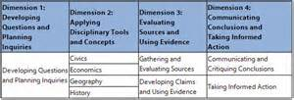
Dimension 3, Evaluating Sources and Using Evidence.
Notes:
Sources come in many forms, including historical and contemporary documents, data from direct observation, graphics, economic statistics, maps, legislative actions, objects, and court rulings. Access to these and other digital sources is now more readily available than ever. The availability of source materials, however, does not translate automatically into their wise use. Students must be mindful that not all sources are equal in value and use and that sources do not, by themselves, constitute evidence. Rather, evidence consists of the material students select to support claims and counter-claims in order to construct accounts, explanations, and arguments. Helping students develop a capacity for gathering and evaluating sources and then using evidence in disciplinary ways is a central feature of the Inquiry Arc represented by Dimension 3, Evaluating Sources and Using Evidence.
Linda will begin here.

Slide 13
Why should primary students understand sourcing?
K.HT.15 Interpretation and Synthesis
Identify different kinds of historical sources.
1.HT.15 Interpretation and Synthesis
Identify the maker, date and place of origin for a historical source from information in the source while explaining how the source can be used to study the past.
2.HT.15 Interpretation and Synthesis
Generate questions about a historical source and explain how the source is related to a historical development or event.
3.HT.15 Interpretation and Synthesis
Compare information provided by different historical sources about the past.
Notes:
It is part of the proposed standards for Social Studies for every grade level and it begins in KINDERGARTEN!

Slide 14
Why should primary students understand sourcing?
4.HT.15 Interpretation and Synthesis
Analyze the information gathered from historical sources (maker, date, place of origin, audience and purpose), to judge the extent to which the sources are useful for studying a particular topic.
5.HT.15 Interpretation and Synthesis
Infer the intended audience and purpose of a historical source by sourcing the document in order to generate questions about how it relates to particular events and developments.

Slide 15

Primary and Secondary
Sources
http://www.slideshare.net/mobile/jjgarcia77/primary-source-quiz-presentation
Notes:
http://www.slideshare.net/mobile/jjgarcia77/primary-source-quiz-presentation
Handout on primary and secondary sources. Reviewing the questions sections.

Slide 16

Formative Assessment Time
The following slides contain pictures, text, and other sources.
Discuss with table mates.
Select the card with P for primary, S for secondary, or E for either to identify the object.
Be prepared to justify your answers.

Slide 17
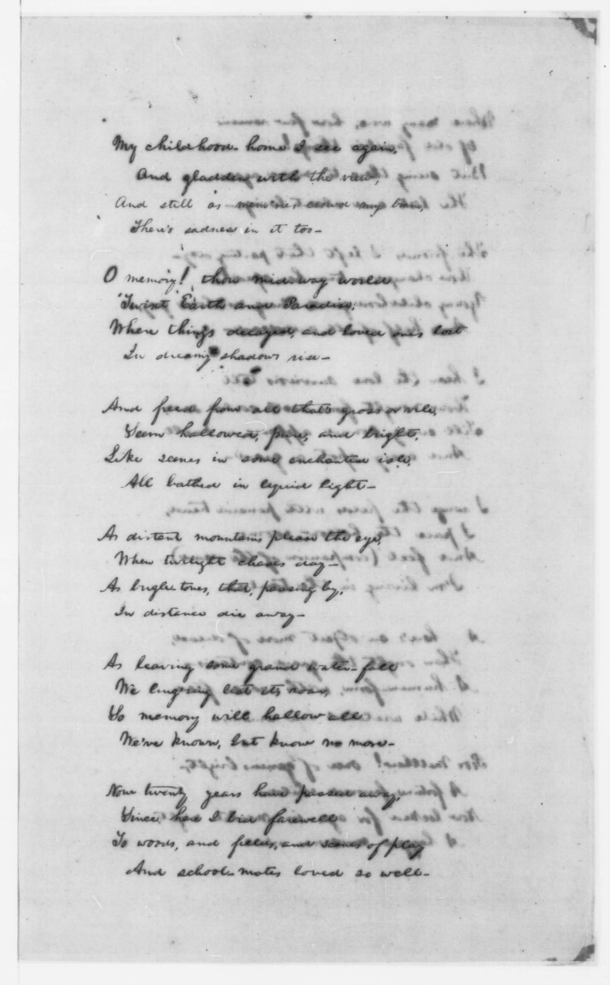
P, S, or E
P

Slide 18
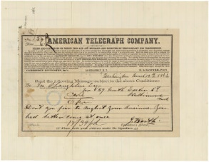
P, S, or E
P

Slide 19

P, S, or E
S

Slide 20
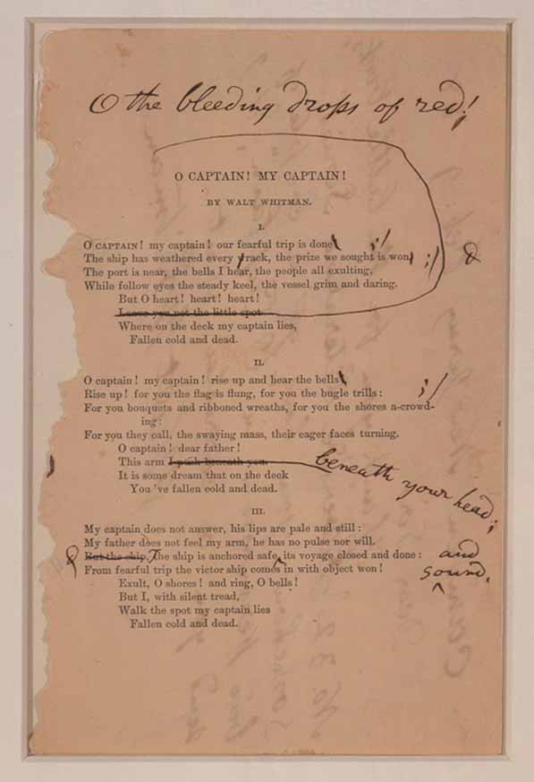
P, S, or E
S,E

Slide 21
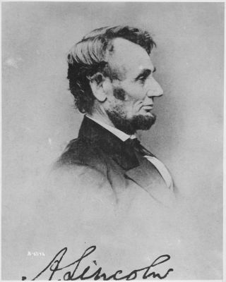
P, S, or E
P

Slide 22
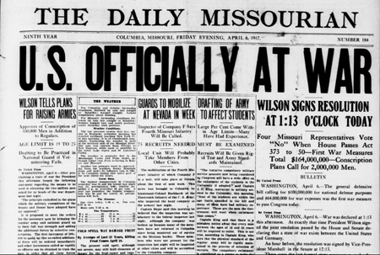
P, S, or E
S

Slide 23
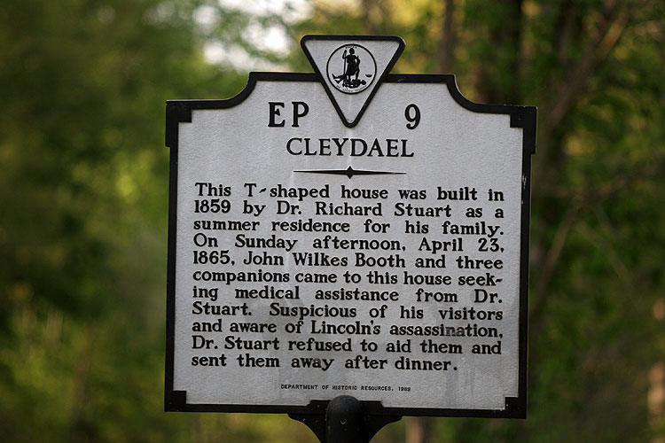
P, S, or E
S

Slide 24

Let’s Explore Lincoln Sources
With a partner go to the Lincoln resource display. Go through several of the books and articles. List as Primary of Secondary.
Discuss findings with other groups.

Slide 25
Let’s Revisit Lincoln
Review the information on Lincoln. Locate different primary and secondary sources.
Use handouts to produce open and closed questions.
On the index card given to you, you have a quote by Lincoln and a number on the back of your card.
Read the quote and write 3 questions on the back that you would want answered. (at least 1 question must be open)
Make the questions connect to the primary or secondary sources when possible.
Notes:
5 minutes. Redistribute the cards. Go over the rules for Structured Turn Taking.

Slide 26
Students Generating Questions
Structured Turn Taking
  Note card per student with # on one side and a quote from Lincoln on the other side.
  Write 3 question(s) about Abraham Lincoln’s
  message using primary or secondary source
  to support your conclusions.
  3. Note cards retrieved and redistributed
  4. Card #1 reads quote and discussion
  (Block, 2004)
Notes:
Strategy Source: Teaching Comprehension: The Comprehension Process Approach by Cathy Collins Block, 2004, Pearson Education, Inc.
Structured Turn Taking allows students to generate questions about the reading and/or ideas that spring from reading text and can be implemented in a variety of ways.
The following procedures are basic steps:
Students read a story or a story is read through an auditory method.
Students are given a note card with a number on one side. (Each student should have a card with a different number.)
Students are then asked to write down a question(s) they have about the text or an idea for class discussion that arose from reading the text.
Note cards are retrieved and redistributed to different students who read their newly acquired question(s) and think of a way to start the discussion with the group.
The student who has #1 reads his/her question or topic aloud and begins class discussion. This process continues until all questions or topics have been discussed from student cards.

Slide 27
Session Targets
I can make connections using ELA Standards, 3C Framework, TGES and Social Studies draft standards.
I can distinguish between primary and secondary sources.
I can participate in a structured turn and talk discussion.

Slide 28
Reflection Time
In your journal write down the main points that you want to make with your teachers.

Slide 29
EXIT SLIP
Notes:
After viewing the sources on Lincoln and participating in the structured turn taking activity, as an exit slip take a post-it note and write one adjective on Lincoln.

