Slide 1
Using questioning with accountable talk in the social studies classroom
Linda Holbrook
Mary McCloud
Dionne Bates

Slide 2
Targets
I can use Reading Standard 1 in planning for questioning.
I can use primary sources to initiate a formal discussion.
I can promote student discussion by scaffolding.
Students extend the discussion, enriching it.
I can use accountable talk to generate a discussion.
Students invite comments from their classmates during discussion.

Slide 3
C3Framework Reading Standard 1
RI.K.1 With prompting and support, ASK and answer questions about key details in a text.
RI.1.1 Ask and answer questions about key details in a text.
RI.2.1 Ask and answer such questions as who, what, when, why, and how to demonstrate understanding of key details in a text.
RI.3.1 Ask and answer questions to demonstrate understanding of a text, referring explicitly to the text as the basis for the answers.
RI.4.1Refer to details and examples in a text when explaining what the text says explicitly and when drawing inferences from the text.

Slide 4
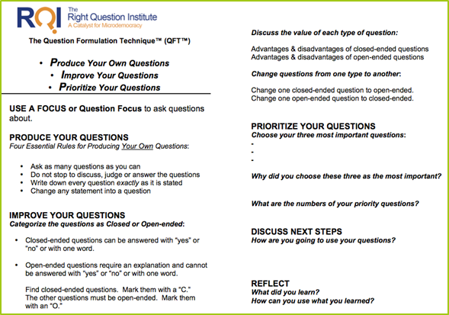
Components of the Question Formulation TechniqueTM
A Question Focus (Q-Focus)
Rules for Producing Questions
Producing Questions
Categorizing Questions-Open/Closed
Prioritizing Questions
Next Steps
Reflection

Slide 5
Rules for Producing Questions
Ask as many questions as you can.
Do not stop to answer, judge, or discuss.
Write down every question exactly as it was stated.
Change any statements into questions.
Reference your handout for Question Formulation Technique.
Notes:
Carole

Slide 6
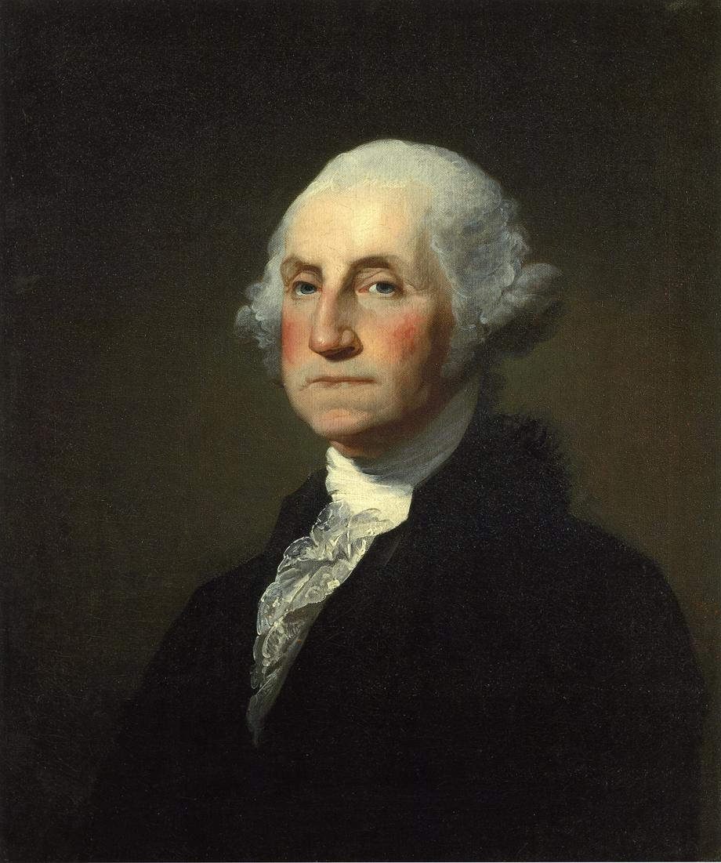
Do you recognize this man?

Slide 7
Categorizing Questions: Closed/Open
Definitions:
Closed-ended questions can be answered with a “yes” or “no” or with a one-word answer.
Open-ended questions require
more explanation.
Directions: Identify your questions as closed-ended or open-ended by marking them with a “C” or an “O”.
Notes:
Carole
Follow directions on slide and “Improve Your Questions” on QFT handout

Slide 8
Let’s begin writing questions Remember open and closed

Slide 9
Watch the video use Anchoring Sheet for questions

Slide 10
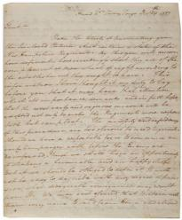
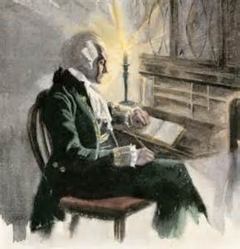
Close Reading of Primary Source

Slide 11
Prioritizing Questions
Review your list of questions
Choose the three questions you consider most important
While prioritizing, think about your Q-Focus:
George Washington General Thriving and Surviving Valley Forge
Notes:
Carole
Follow directions on slide and “Prioritize Your Questions” on QFT handout

Slide 12
REFLECTION
Why did you choose those three questions as the most important?
Where are your priority questions in the sequence of your entire list of questions?
Which questions at your table are the most likely candidates for compelling questions? Supporting questions?
Notes:
Carole
Follow directions on slide and “Prioritize Your Questions” on QFT handout

Slide 13
Accountable Talk

Slide 15
Let’s Give a Try
Bring your anchoring chart and Accountable Talk question stems to the circle. Use the stems to expand the discussion.

Slide 16
Points to remember
Ask and answer questions is the core of Reading and the C3Framework.
Use primary and secondary sources to provide students with the background knowledge needed to question the text

